Slide 1
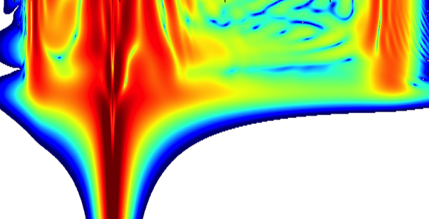
Tiny Rainbow Lasers how photonic-chip supercontinuum generation is making optical frequency combs smaller, faster, and better
Dan Hickstein, David Carlson, Abijith Kowligy, Alex Lind, Connor Frederick, Henry Timmers, Wei Zhang, A.J. Metcalf, Holly Leopardi, Judith Olson, Rich Fox, Tara Fortier, Frank Quinlan, Daniel Cole, Jordan Stone, Travis Briles, Erin Lamb, Scott Diddams, Scott Papp NIST – Time and Frequency Division, Boulder, Colorado
Ian Coddington, Edgar Perez, Nima Nader, Jeff Chiles, Gabriel Ycas, Esther Baumann, Paritosh Manurkar, Stefan Droste, Nathan Newbury NIST – Applied Physics Division, Boulder, Colorado
Kartik Srinivasan, Qing Li, Daron Westly NIST – Center for Nanoscale Science and Technology, Gaithersburg, Maryland
Hojoong Jung and Hong Tang Yale University – Department of Electrical Engineering New Haven, Connecticut
Notes:
Thank you all for coming to my talk. My name is Dan Hickstein, and I work with Scott Diddams and Scott Papp in the Optical Frequency Measurements Group. The results I’m going to show you are the result of contributions from a whole bunch of different people. I work with a great team of scientists here at NIST Boulder, both in the Time and Frequency Division, as well as the Applied Physics division. Also, we have been collaborating with Teams at NIST Gaithersburg, and at Yale.

Slide 2

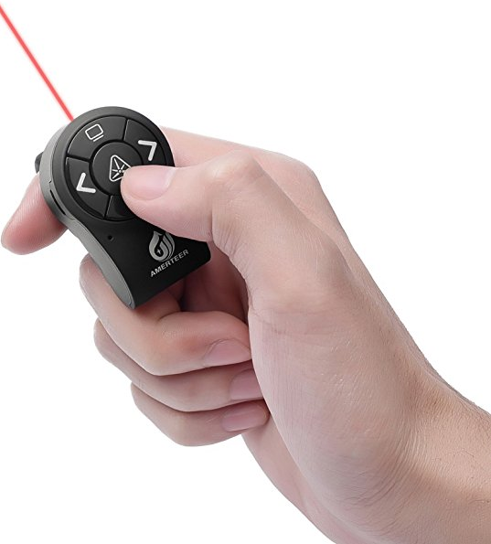
Tiny Rainbow Lasers how photonic-chip supercontinuum generation is making optical frequency combs smaller, faster, and better
Notes:
So, the title of this talk is Tiny Rainbow Lasers. Probably, when you read this title you were hoping that I was going to tell you about some little laser that you can hold in your hand. And, instead of this little red laser beam coming out, the thing just shoots out rainbows. I assume that you’ve had this experience where you come to a talk with a fun title, and then you learn that that, no they aren’t building a “Quantum Rocketship” after all, it was just an analogy for something way more boring.
But, in this case, this picture is almost exactly right! Most of our lasers are bigger than this right now, but in the near future, we would like this thing to be really small, like computer chip size.

Slide 3
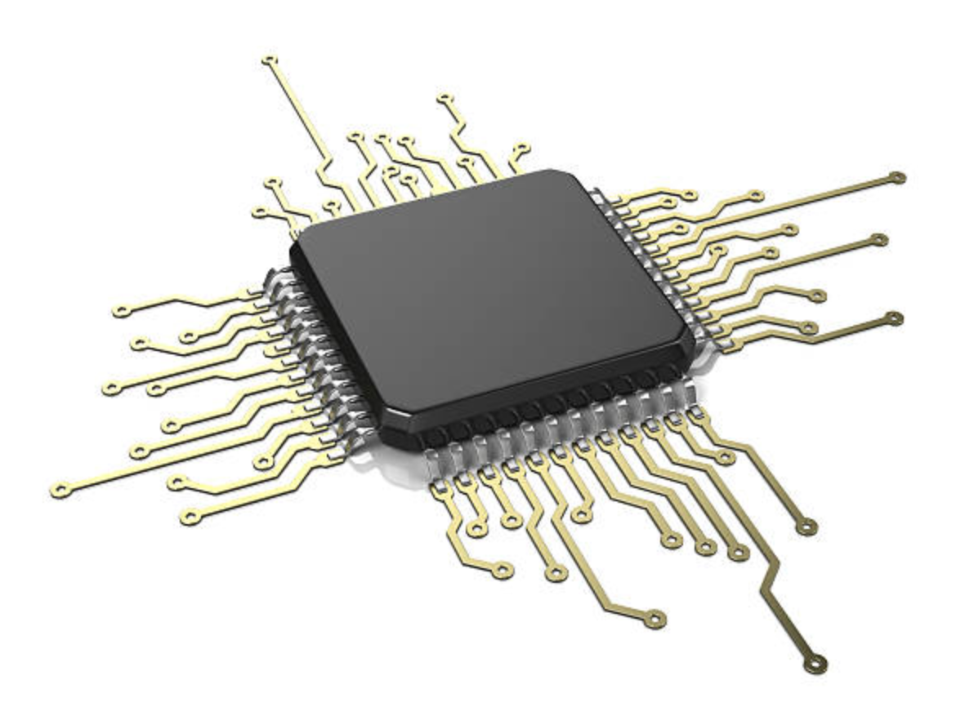
Tiny Rainbow Lasers how photonic-chip supercontinuum generation is making optical frequency combs smaller, faster, and better
Notes:
And, of course, for the rainbow laser to actually hit something with the full rainbow, all of the colors need to travel in the same direction, so it just looks white.

Slide 4
Tiny Rainbow Lasers how photonic-chip supercontinuum generation is making optical frequency combs smaller, faster, and better
Notes:
So, the light would actually just appear white, but it would contain a broad spectrum of different colors, potentially ranging from the ultraviolet all the way to the infrared.

Slide 5
Tiny Rainbow Lasers how photonic-chip supercontinuum generation is making optical frequency combs smaller, faster, and better
Notes:
But don’t worry, you can always use a simple prism to disperse the colors and see the rainbow.
So, if you get nothing else from this talk, you can at the very least be delighted to know that there, like literally thousands of people, who are trying to develop tiny rainbow lasers. Here at NIST, we have some of the tiniest and most rainbow lasers in the world.
But, the next question is why are a bunch of scientists spending so much time studying something that seems so ridiculous, and we at NIST are particularly interested in developing the world’s best rainbow lasers.
The very short answer is that at NIST we are interested in measuring things really well. And a variety of laser called an Optical Frequency Combs is the best way to make very precise measurements of light. And we are currently working to make these frequency combs smaller and better.

Slide 6
Optical frequency comb
Femtosecond laser
1
1
f_{r}
Δν
Time
f_{r}
Intensity
Δν
Hz
Frequency
Notes:
So, what is an optical frequency comb? Well, a frequency comb is just a laser. But, it’s not like a traditional laser that just produces light all the time. It’s a pulsed laser, that only sends out these little pancakes of light. And it depends on the frequency comb, but generally these pulses of light are only a few femtosecond long. And, in case you have forgotten, a femtosecond is 0.000000000000001 seconds.
So, we can make a plot of the laser intensity over time, then it looks something like this, where there are pulses of light that have some brief duration and a constant spacing between the pulses. If we can stabilize the laser, and keep the spacing between the pulses exactly constant, then we can make an optical frequency comb. If we look at the frequency spectrum, which is just a plot of the different colors, then we see that it’s not a continuum of colors like you get from a light bulb, but there are individual teeth that look like a comb. This is why we call it a frequency comb. And, it’s really similar to having thousands or even millions of really stable lasers all operating at the same time and shining in the exact same direction.
And, since we have these teeth, the frequency comb can act like a ruler for measuring other lasers. Why do we need a ruler for measuring lasers?

Slide 7
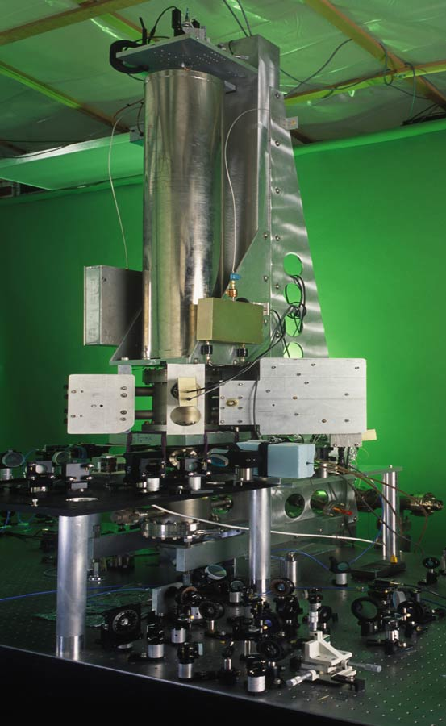
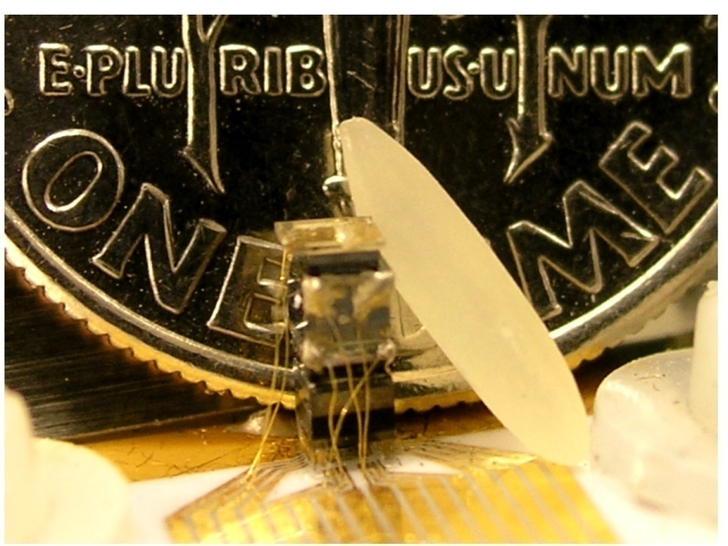
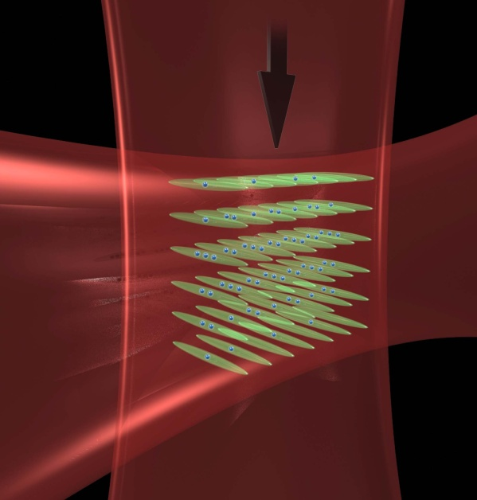
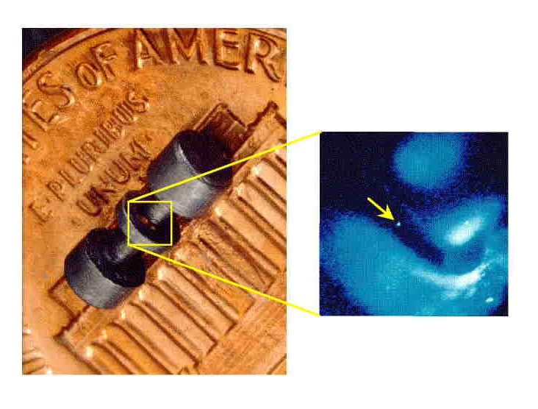
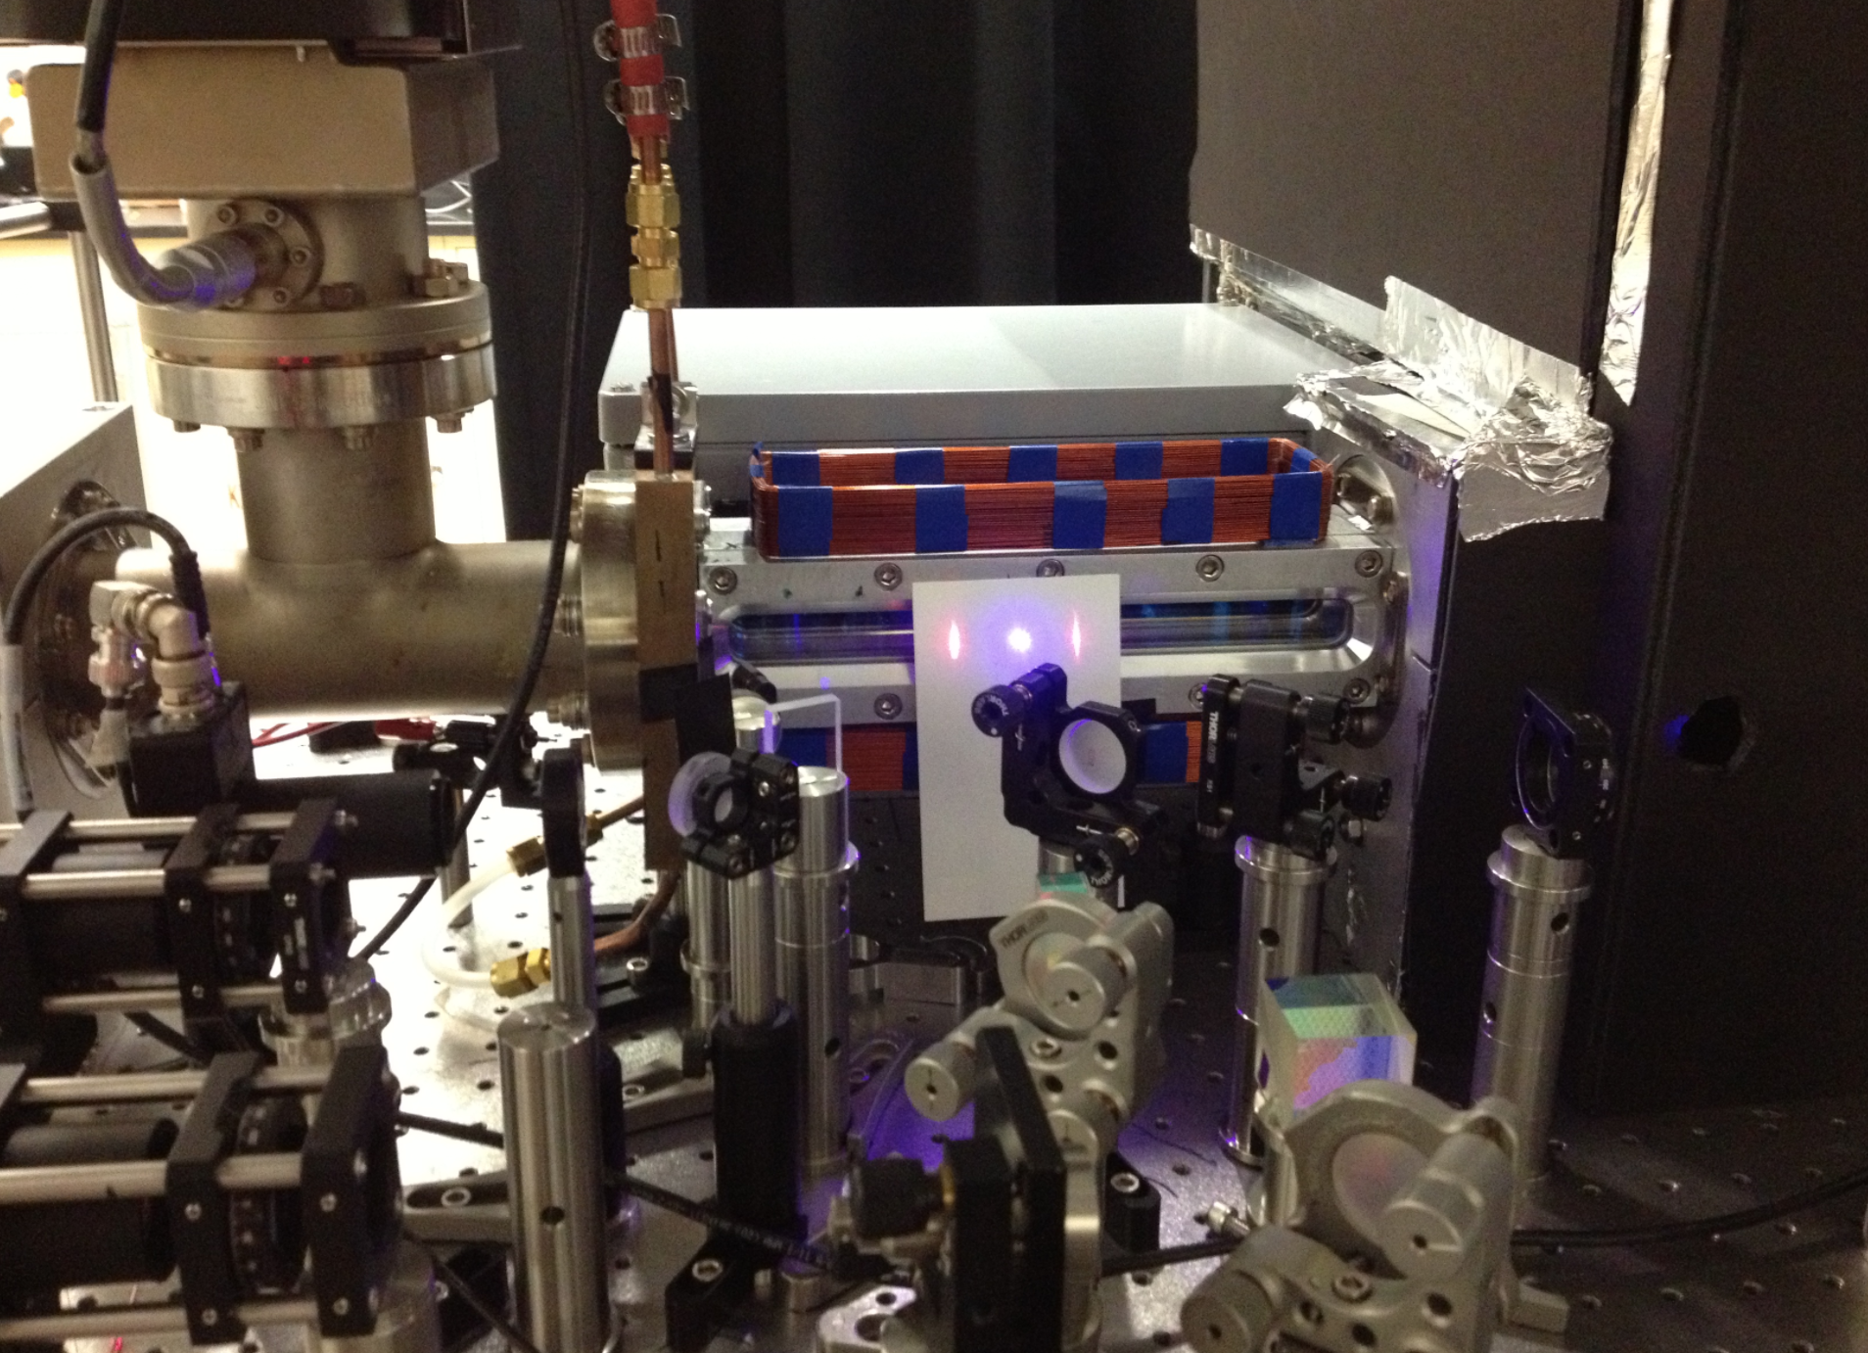
Problem: atomic clocks
Chip-Scale Clocks
Optical lattice clocks
Cs Fountain Clock
Single Ion Clocks
Thermal beam clocks (Ca)
Notes:
Well, at NIST we have a problem: we have a whole bunch of atomic clock. Every few years, it seems like someone has an idea for a newer, more stable type of atomic clock, and we end up with all of these different clocks, all in different rooms. And the problem is, each of these clocks produces a different frequency. You have the cesium clocks producing very stable microwaves, a chip scale atomic clock producing radio-waves, and then a whole bunch of other clocks that are producing super-stable optical signals. They are basically just incredible stable single-wavelength lasers.

Slide 8
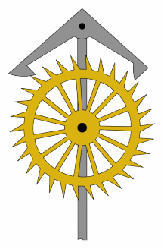
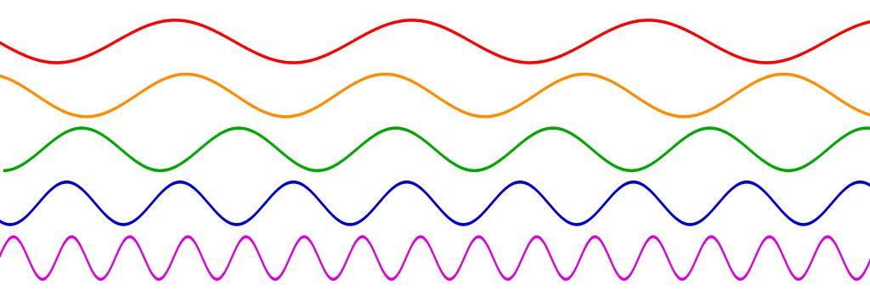
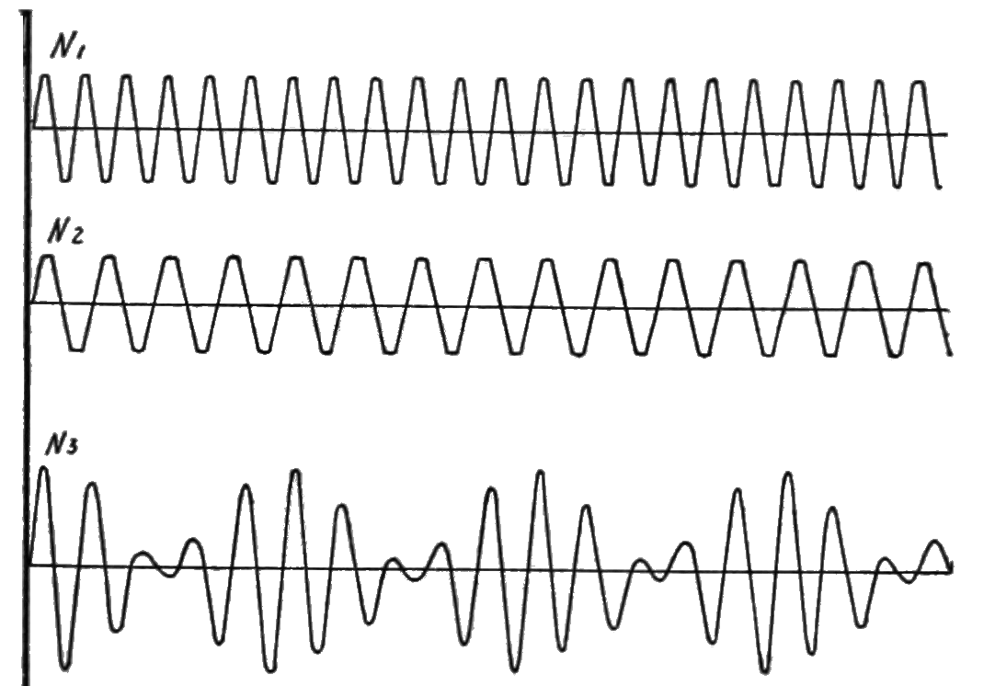
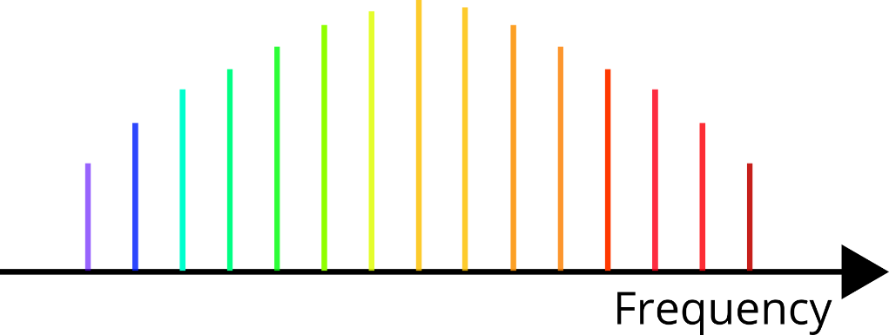
Frequency combs: optical clockwork
Optical clock
Notes:
So, we have all of these different lasers, and we need to compare the stability of each of these. And, they often call these lasers atomic clocks, but they are really more like pendulums. To turn this swinging pendulum into a clock, then you need to have this gear-thing that actually counts each swing of the pendulum.
Unfortunately, the electric field of light swings back and forth really, really fast. This is great, because a faster pendulum lets your clock be more precise in a shorter amount of time, but it presents the practical problem the even our fastest electronics cannot count each cycle of light. Here is where the frequency comb comes in. This atomic clock laser can interfere with the nearest comb-tooth from our frequency comb. And here we use an effect called a heterodyne beat. When two waves with similar frequencies interfere, you get a new wave that is modulated at the difference between the two frequencies. This modulation can take place at a much lower frequency, which can be easily measured using conventional electronics.

Slide 9
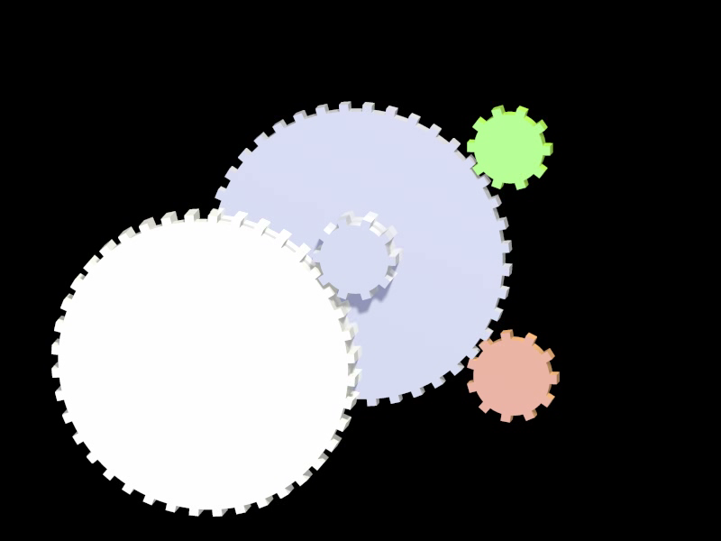
Frequency combs: optical clockwork
Frequency
Comb
ν₁
Optical
frequencies
Radio
frequencies
ν₂
Notes:
So, one major application of frequency combs is as the reduction gear that connects optical frequencies, which can’t be counted, to radio-frequencies, which can be counted using electronics. As you can see in this animation, the optical frequencies are completing one revolution every few seconds, while the radio frequencies are much slower, completing one revolution every minute or so. In reality, these “gears” are spinning trillions of times faster, and the gear ratio isn’t just the 10:1 ratio shows here, but it’s more like 1 million to 1.

Slide 10
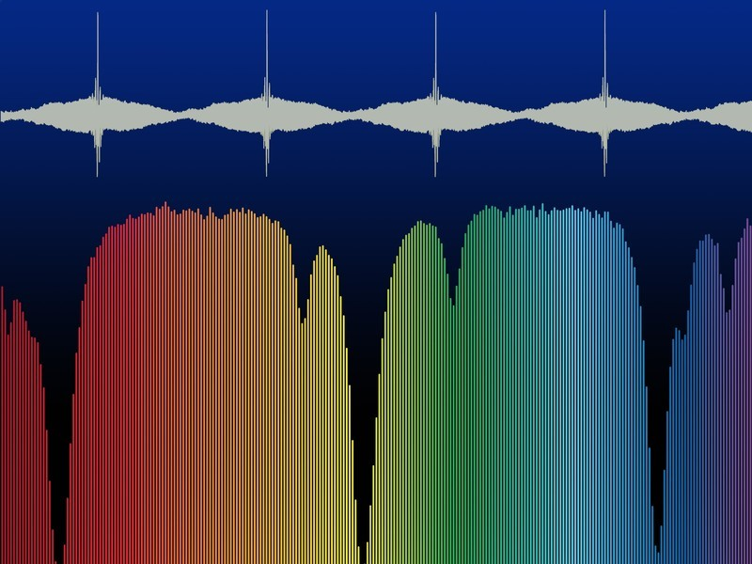
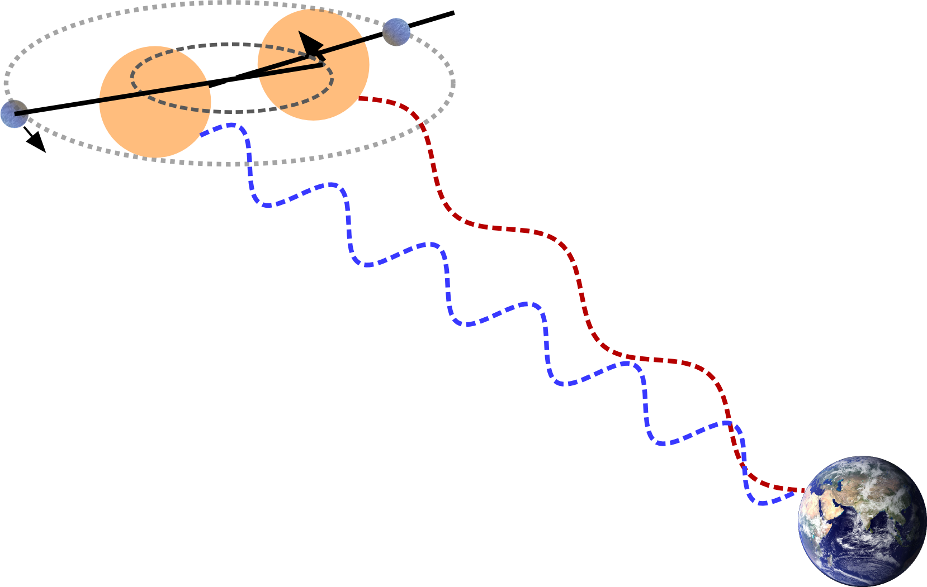
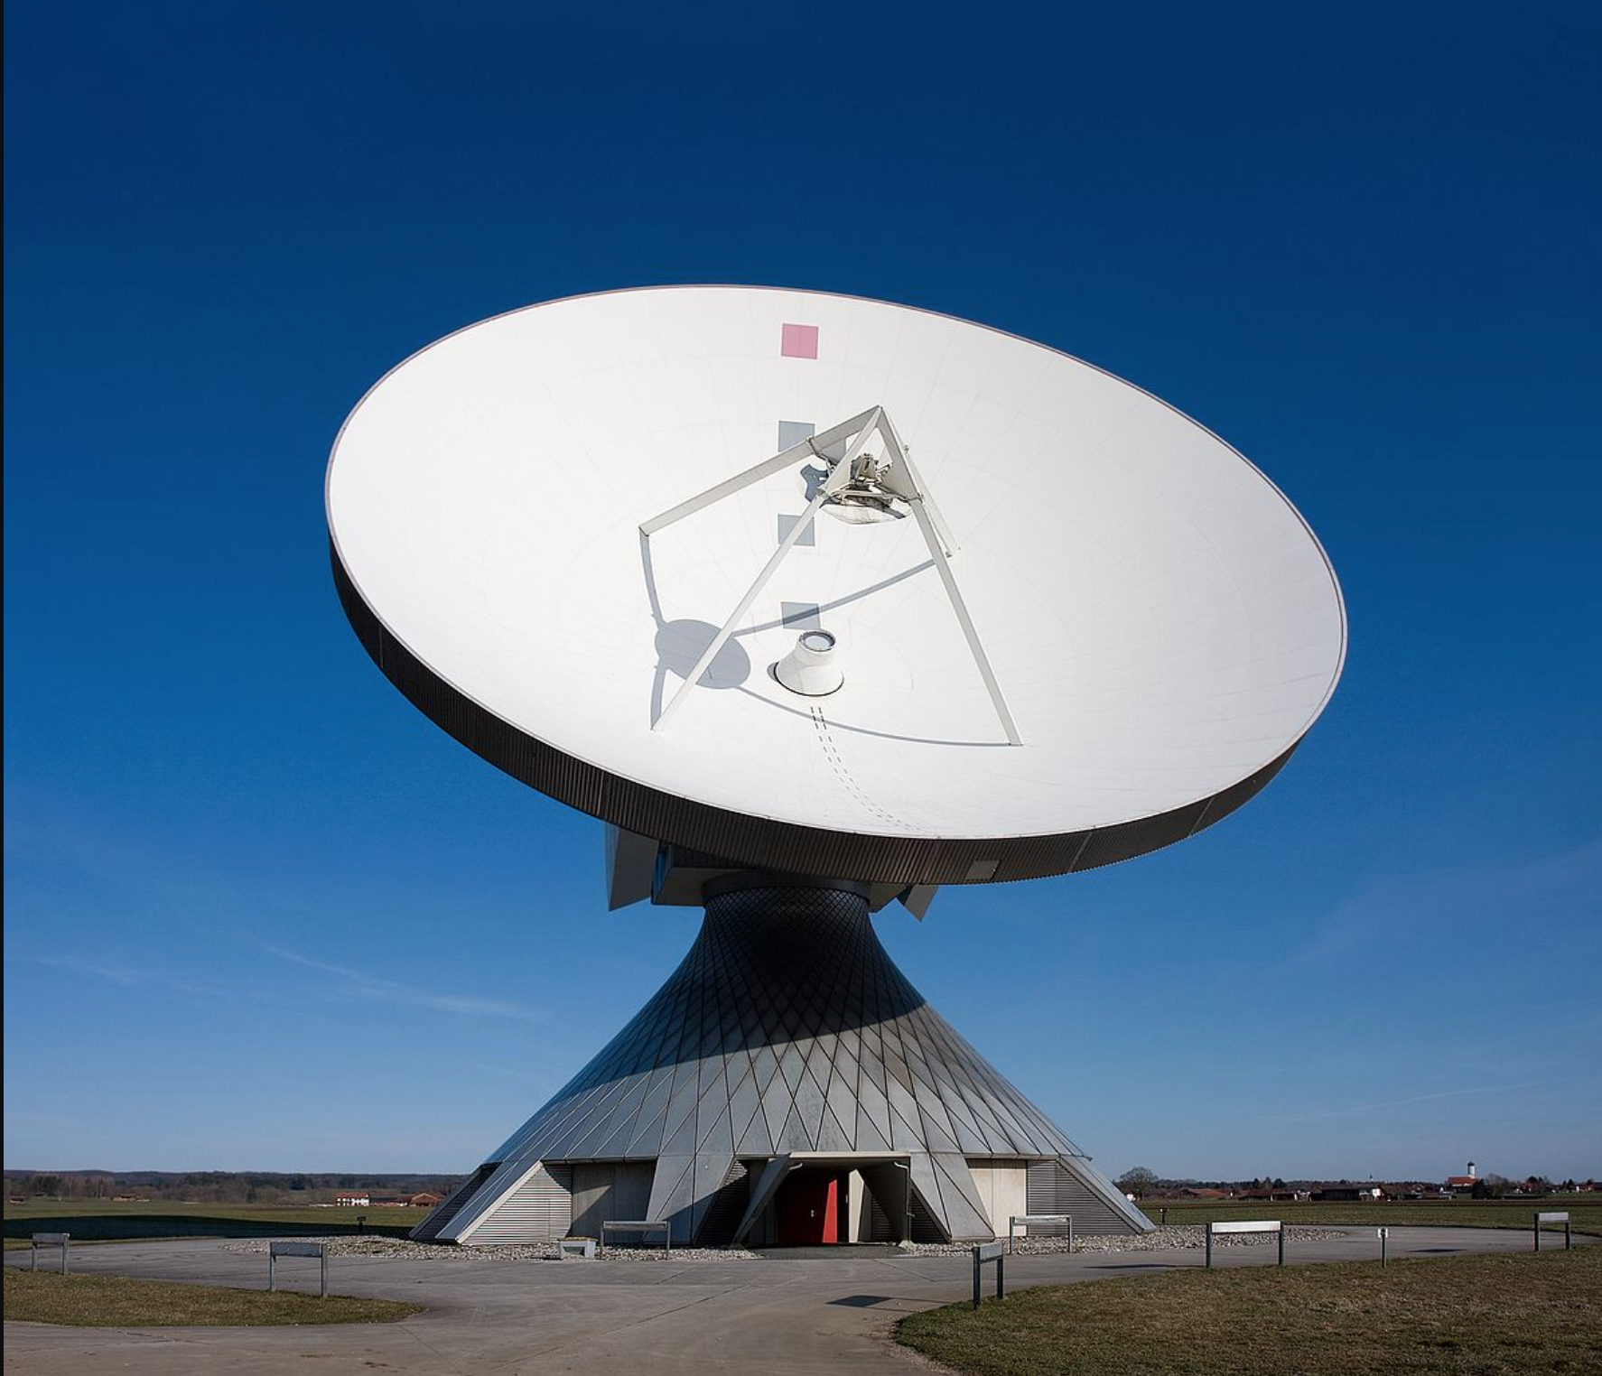
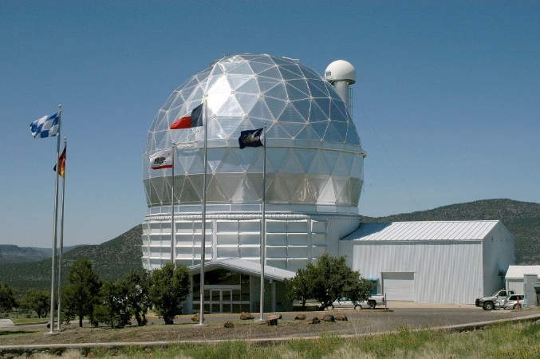
Applications of frequency combs
Calibrating astronomical spectrographs
Planet
Dual-comb spectroscopy
Star
Microwave generation
Hobby-Eberly Telescope
Notes:
The ability to measure light very precisely isn’t just limited to optical clockwork. Frequency combs have proven to be incredible tools for spectroscopy, where the interference between two frequency combs can make high-resolution measurements of the light absorbed by a sample without the need for a diffraction grating or moving parts. Frequency combs are also useful for generating very stable microwave signals, which have potential applications in Radar systems.
Also, as Ryan told you about a few months ago at this seminar, an exciting new application for frequency combs is to calibrate high astronomocal spectrographs that are looking for new Earth-like planets by detecting tiny red-shift and blue-shifts shifts in the light emitted by distant stars.

Slide 11
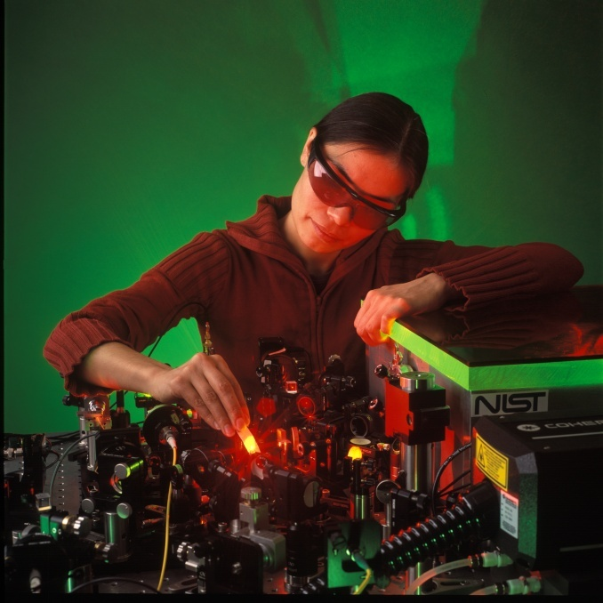
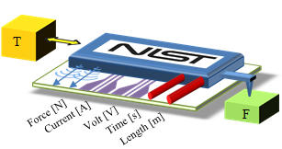
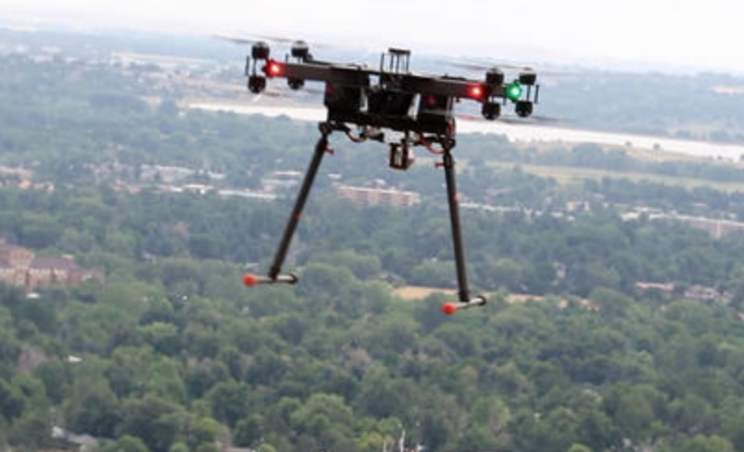
Typical frequency comb
Applications that need new combs:
~80 MHz Ti:sapphire
Notes:
So, what does a frequency comb actually look like? Here is a photograph of a modelocked titanium sapphire laser, which has been the most common laboratory frequency comb for many years. If you are looking for a really good frequency comb to use in the lab, these are awesome, super-stable lasers. But, as you can see, it’s a relatively bulky system. Many of the applications of frequency combs involve taking the combs out of the lab and into the world.
Atomic clocks are getting smaller and more robust and will require that the combs follow suit.
For example, there is a big push to develop a “NIST of a chip” device which would deliver all sorts of standards in tiny package. One of these outputs is a frequency comb. Also, dual comb spectroscopy has proven to be really useful for monitoring gases in the atmosphere. So, if combs were portable enough to be mounted on a tiny drone, this could be a much more powerful tool.
As you can imagine, this type of lab-scale comb isn’t really compatible with these applications. You need to plug it into the wall, it’s pretty heavy, and you need to somehow fit this scientist onto the drone to keep all of the optics aligned.

Slide 12
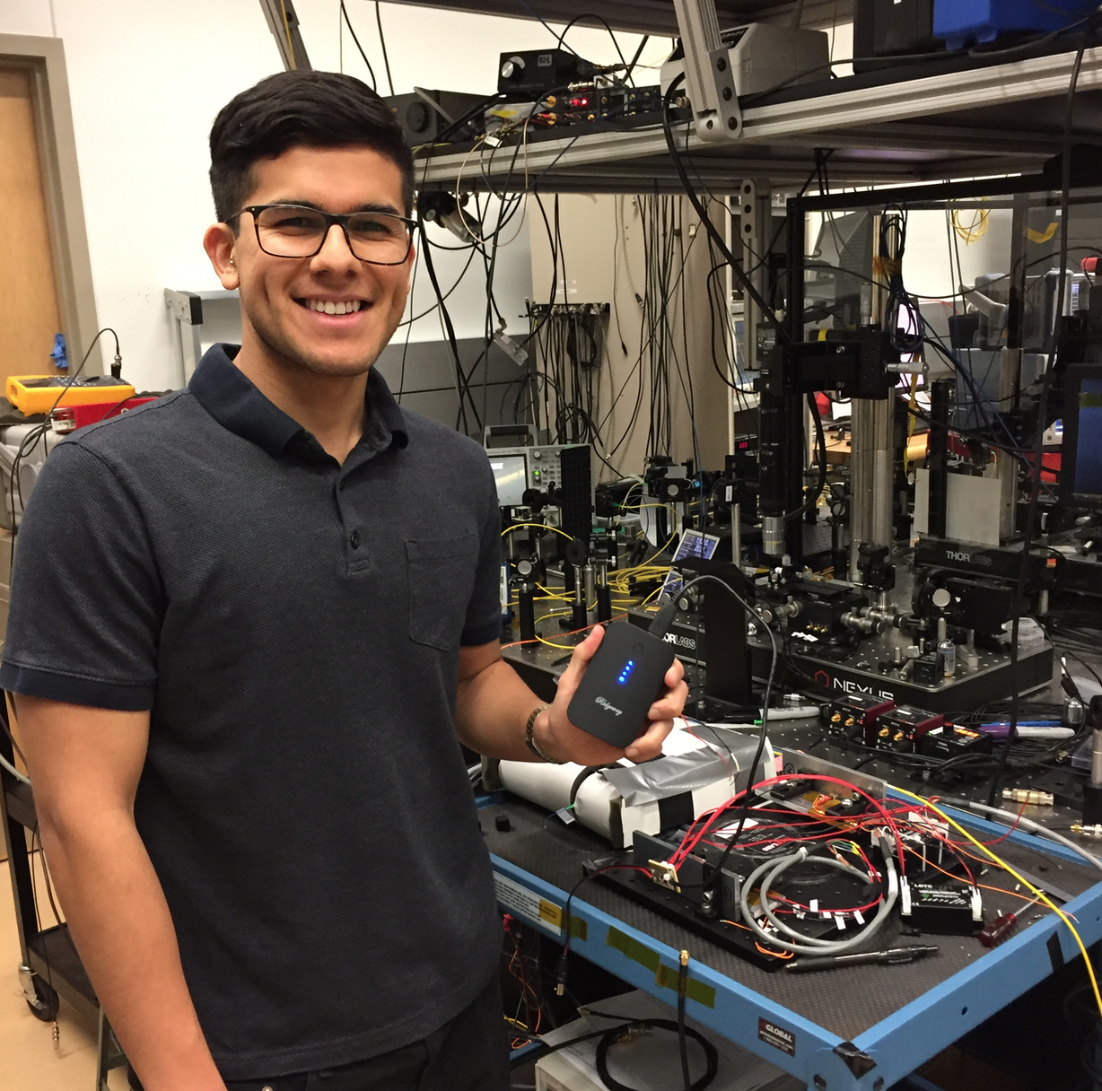
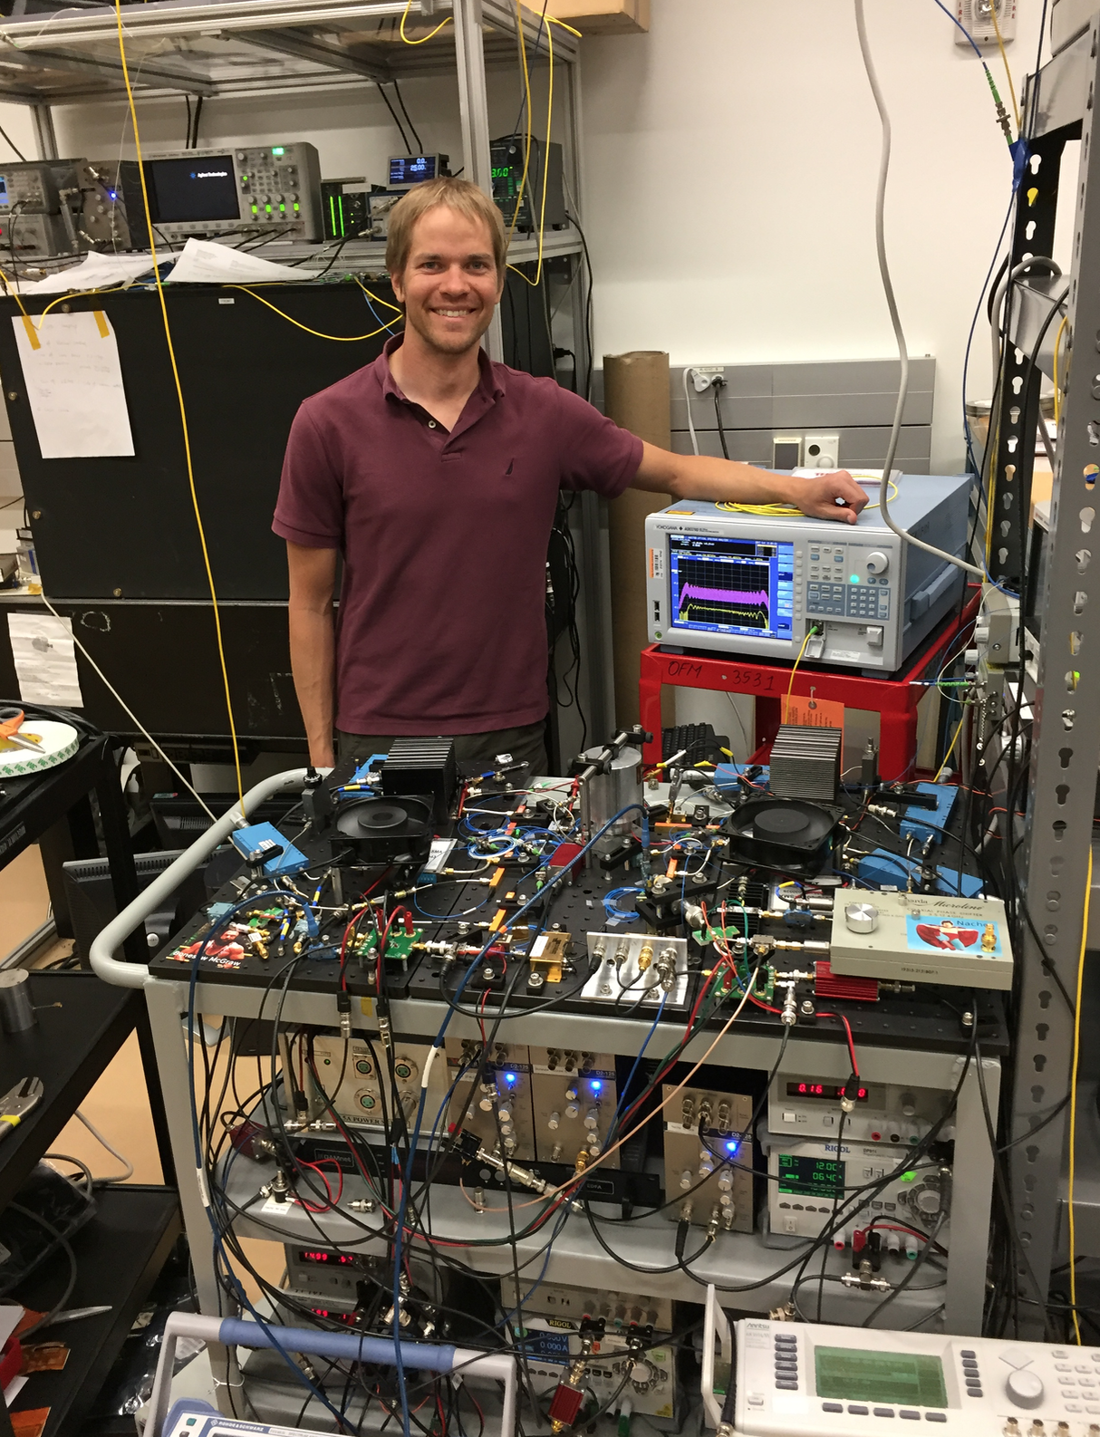
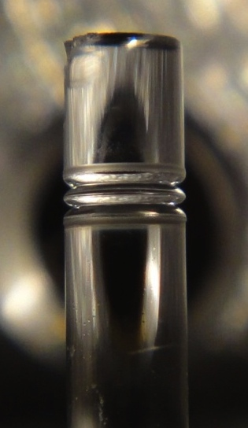
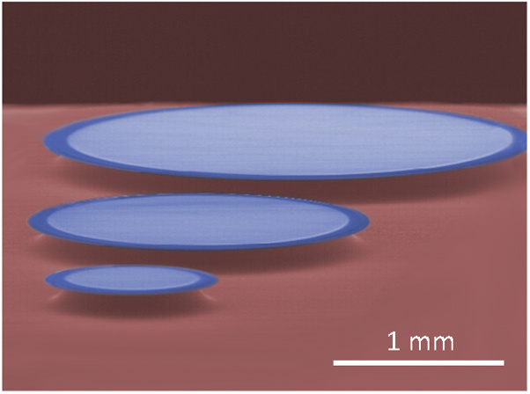
Next generation frequency combs
100 MHz Low-power Er:fiber
10 GHz Electro-optic (EO) comb
~15 GHz rod-resonator
~15 GHz microresonators
2 mm
Notes:
Fortunately, there are new types of frequency combs being developed. On the left, here is Edgar, from Nate Newbury’s group posing a low-power consumption Erbium fiber comb. This comb still operates at 100 MHz, but it draws less than 5 Watts of electrical power, and so it can run on this tiny cell phone charger.
On the right here, here is my labmate David posing with our new electro-optic comb. This comb isn’t particularly small yet, but it shoots out pulses much faster than a traditional frequency comb, which makes it ideal for calibrating astronomical spectrographs and high-speed spectroscopy.
Going smaller, our group works with these millimeter scale microrod resonators and microresonators.
All of these sources produce great frequency combs, but they have one problem: They are not rainbow enough! They produce a narrow spectrum with not very many colors. And, if a frequency comb isn’t sufficiently rainbow, it’s a bit worthless by our standards.

Slide 13
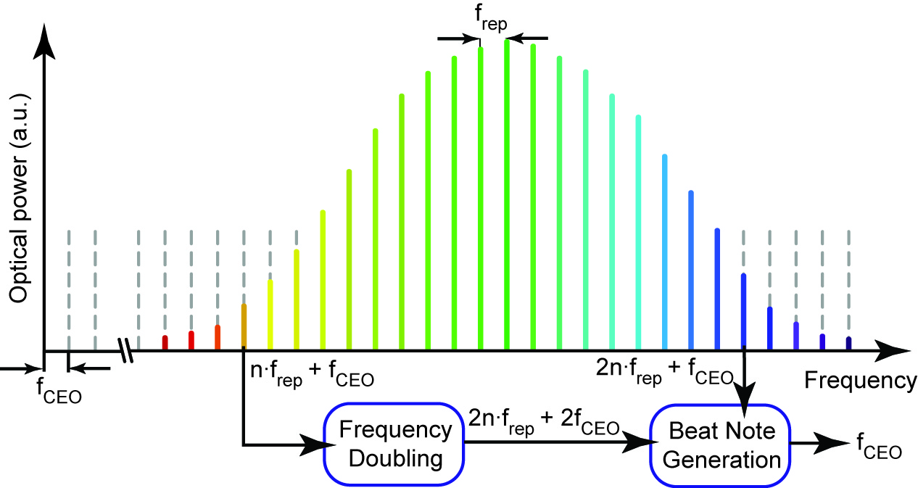
Broadband combs: self referencing
Broadband frequency combs:
Optical clock comparison
Spectroscopy
Spectrograph calibration
f-2f self-referencing
Notes:
In general, we want our combs to have a fairly large bandwidth. There are a few obvious reasons for this. Obviously you need a broad enough bandwidth to compare the different optical clocks that you are interested in comparing. Similarly, if you want to do spectroscopy on some molecules in the air, you need to have the right wavelengths needed to probe those molecules. Also, if you want to calibrate an astronomical spectrograph, you need to provide a large bandwidth to match the spectrometer.
But, probably most importantly, is that a frequency comb needs to have at least one octave of bandwidth in order to use what is called f-2f self referencing to stabilize the offset frequency. Basically, even after the spacing between the comb teeth has been stabilized, the comb can still shake from side-to-side such that there is a little gap between zero frequency and the position of where the very first comb tooth would be.
Unfortunately, frequency combs are usually generated with way less than one octave of bandwidth.

Slide 14
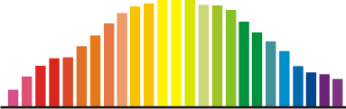
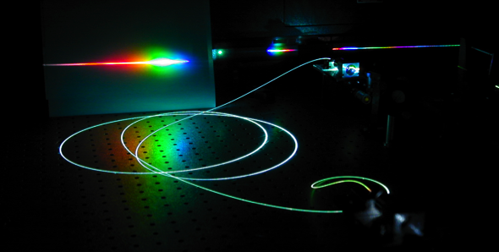
Supercontinuum generation
Narrowband pulses
Broadband light
Nonlinear fiber
Needed: ~1 nJ, 100 fs (~10,000 Watts peak power)
Next-generation combs: 100 pJ, 200 fs (~500 Watts peak power)
Notes:
Fortunately, narrowband combs can be converted into broadband combs through a process known as supercontinuum generation. On one level, supercontinuum generation is pretty simple. Basically, you take relatively narrowband laser pulses, shine them into some sort of nonlinear optical material, and out comes broad bandwidth light. Special nonlinear fibers are commonly used for this, and here you can see a nonlinear fiber glowing and generating a supercontinuum across the visible region.
But, as you might imagine, this process only occurs for a pretty powerful laser. As a rule of thumb, if your pulses are 100 fs long, then you need about 1 nanoJoule, or about 10,000 Watts of peak power in order to generate an octave spanning supercontinuum spectrum. Many of these new frequency comb sources produce nice pulses, but because they are trying to run on very low electrical power, or because they are at a very high repetition rate, and their average power is spread out between many pulses, they often fall short of reaching this peak power. For example, some low power erbium fiber combs might produce 100 or 200 pJ with 200 fs pulse duration, so they fall short of peak intensity required for supercontinuum generation by at least an order of magnitude.

Slide 15
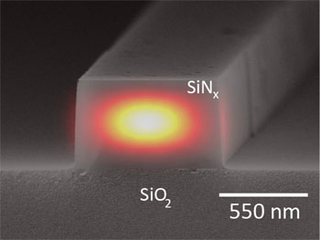
On-chip supercontinuum generation
On-chip photonic waveguides:
Small mode area
High peak intensity
Dispersion engineering
Highly nonlinear materials
Lithographically patterned
Small, customized, scalable
Notes:
For many years, nonlinear fibers were the best option for supercontinuum generation. However, in the past few years, on-chip photonic waveguides have started to be used for supercontinuum generation. These waveguides are created using thin film deposition techniques and photolithography. Basically the same way that computer chips are made.
These “photonic waveguides” have a few advantages. First, they have a really high contrast between the refractive index of the waveguide and the refractive index of the surrounding material, in this case, SiO2 and air. The small mode area means that the light is squished into a tiny area, which increases the the intensity of the light in terms of Watts per square centimeter. The small size also allows us to tune the refractive index as a function of wavelength, which we call dispersion engineering.
Additionally, these waveguides can be made of many different nonlinear materials, like silicon nitride shown here, and these materials can have a much higher nonlinearity than regular glass. And, potentially most importantly, these waveguides are made using lithographic techniques, it’s just as easy to make a chip with hundreds of different waveguides than it is to make a chip with a single waveguide.
When I first started as a postdoc at NIST almost two years ago, this was my project. Scott Papp and Scott Diddams said to me, “Hey, we are developing these new types of frequency combs, and they are super great, but they have narrow spectra and regular nonlinear fiber is probably not going to work. You should check out these on-chip waveguides.”

Slide 16
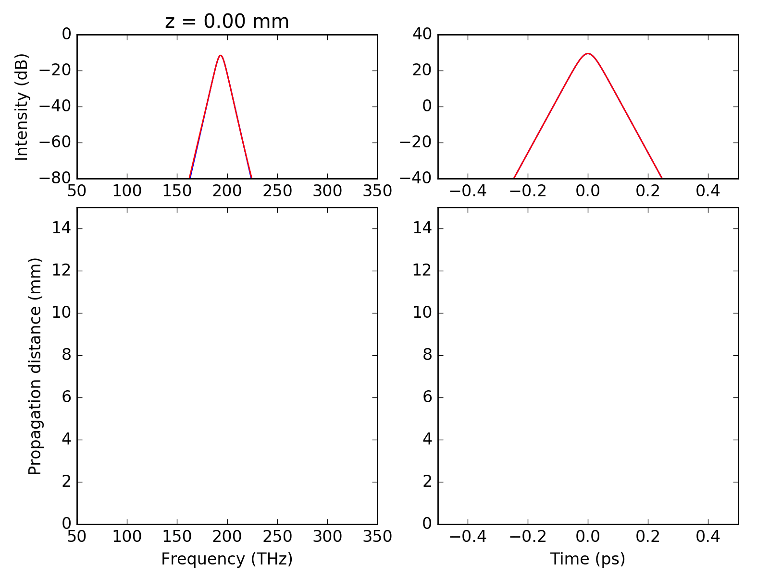
Supercontinuum simulations (NLSE)
50 fs, 50 pJ
Notes:
So, the first step was to see if if the concept worked in theory. This involved using a numerical modesolver to calculate the refractive index of the waveguide at many different wavelengths and for many different sizes of waveguide. Then, I could use another program to simulate the propagation of the light according to the nonlinear schrodinger equation.
Here are the results of the computer model for a 50 picoJoule pulse propagating through a hypothetical silicon nitride waveguide. Here I am plotting the intensity of the light in the frequency domain, and here is the intensity of the light in the time domain.
These bottom plots show the same data, but as a function of the position in the waveguide. Here in the time domain, you can see the pulse breaking up into two pulses that remain the same duration, which are called solitons. So, this regime of supercontinuum generation is called soliton fission. This corresponds to the point where the spectrum becomes really broad in the time domain. If we just care about getting a broad spectrum, then we can make the waveguide as long as we want. But, if we want to get a really short pulse, then it’s important to make the waveguide just the right length.
I ran a whole bunch of simulations like these for various pulse durations, pulse energies, and different waveguide geometries and materials. The results looked really promising, and we predicted that these silicon nitride waveguides should allow us to generate spectra that are much broader than what can be generated with regular silica fibers, and also that we should be able to generate octave spanning supercontinuum using much lower pulse energies that was previously possible.

Slide 17
Waveguide supercontinuum
Can on-chip supercontinuum sources:
Access “inaccessible” wavelength regions?
Provide additional control over the spectral shape?
Generate high-harmonics?
Simplify self-referencing?
Self-reference battery-powered combs?
Provide few-cycle pulses at 10 GHz repetition rates?
Notes:
But, who knows, maybe the simulations were giving us an overly optimistic view of reality. So, we designed a few experiments to answer our questions about what these waveguides could really do.
So, we had a whole bunch of questions about what waveguide supercontinuum could accomplish, and we conducted experiment to answer these questions.
First, we wanted to know if waveguides would allow us to generate light in spectral regions that were otherwise inaccessible using a traditional supercontinuum source.
Second, we wanted to know if waveguides would give us some additional control over the spectral shape of the supercontinuum.
We wanted to know if we could use simultaneous second harmonic generation and supercontinuum generation in a single waveguide to produce a simplified self referencing setup.
Next, we wanted to know if the waveguides would work in the mid-IR, and if high harmonic generation was possible.
Can waveguides allow us to use pulse energies so low that we can still broaden and self-reference a comb that runs entirely on a small battery pack.
Finally, we wanted to see if the waveguides could broaden the spectrum and compress the pulse to just a few optical cycles, even at 10 GHz repetition rates?
So, I’ll briefly tell you about the experiments that we completed that showed that the answer to all of these questions was yes.

Slide 18
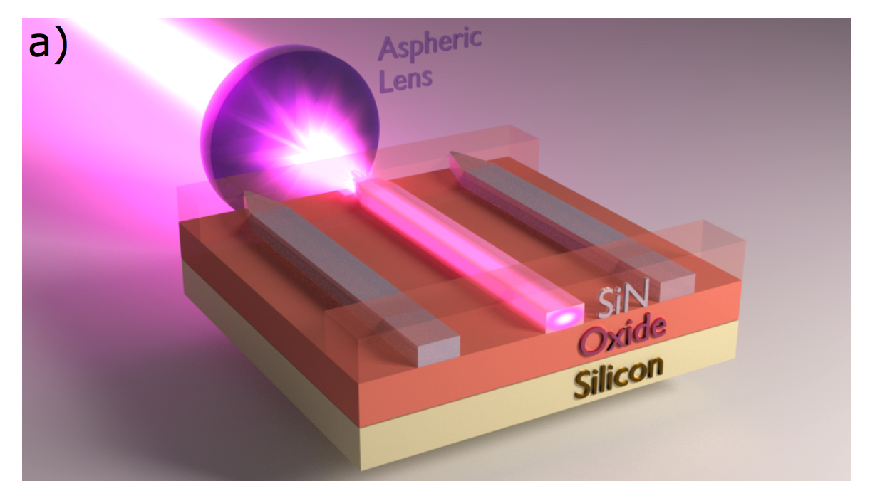
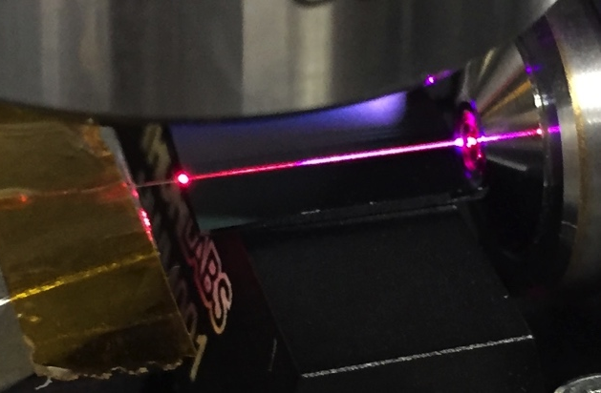
1. Broadband supercontinuum with silicon nitride
Silicon nitride:
Transmission across visible and NIR
Fabricated with CMOS process
Effective nonlinearity: ~100x SiO₂ fiber
80 fs pulses @ 1550 nm
1 cm
Notes:
So, the first question is: what wavelengths can we generate with a 1550 nm laser using on-chip waveguides? For this, and many of our other experiments, we used silicon nitride waveguides, because they have good transmission in the visible and near-infrared region, are easy to fabricate, and have an effective nonlinearity that is about 100 times that of typical silica fiber.
And the basic setup is shown here, we are just coupling a femtosecond laser into these on-chip waveguides using a short focal length lens. And here is a picture of one of these chips glowing with visible light.

Slide 19
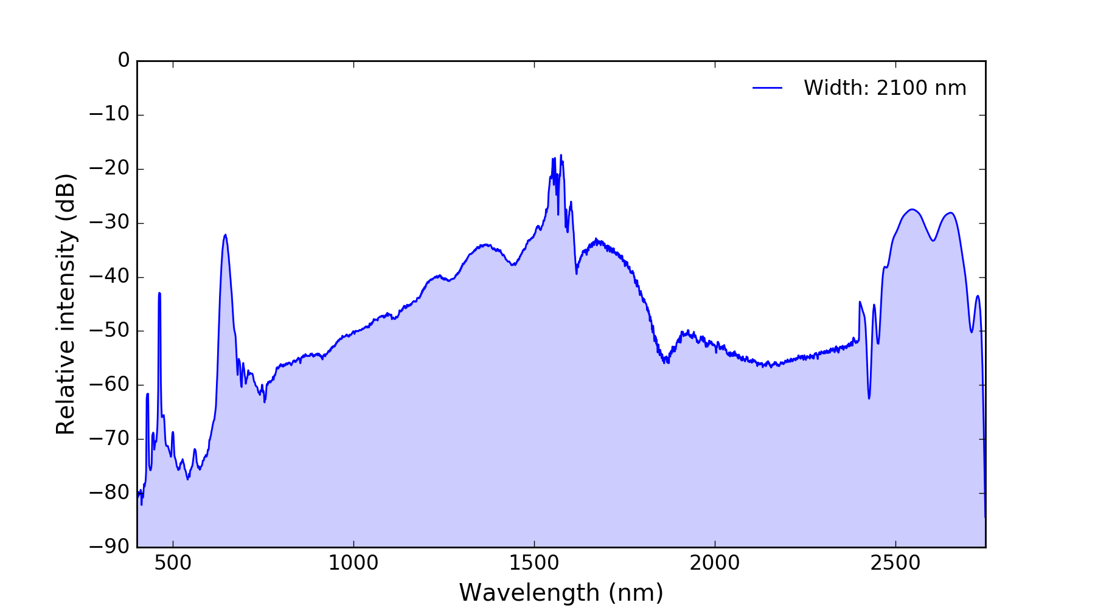
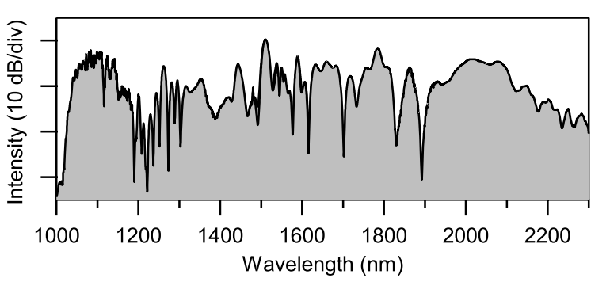
Experimental supercontinuum
Long wavelength
Dispersive wave
Short wavelength
Dispersive wave
1550 nm pump
Notes:
And here is a typical spectrum from one of these waveguides. We are pumping here at 1550, and we see very broadband light. We have two peaks, one on the short wavelength side, and the other on the long wavelength side, and the location of these peaks is determined by the dispersion, and so it depends on the dimensions of the waveguide.
For comparison, here is a typical spectrum produced with a similar laser using nonlinear fiber. You can see that we are generating light at much shorter and much longer wavelengths than is typical.

Slide 20
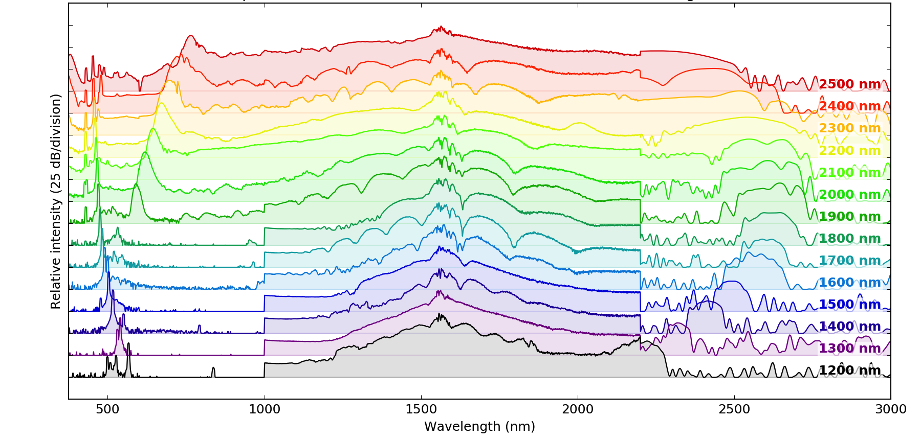
Tunable spectrum
Experimental supercontinuum from ~640-nm-thickness SiN waveguides
Notes:
And, the best part is that we have a whole chip packed full of different waveguides, and we can just move the translation stage a little bit and select a different waveguide size. And this changes the spectrum that is generated!
Here I am plotting the supercontinuum generated from waveguides that are all on the same chip, and all with the same height, but each waveguide has a different width. Since the waveguide geometry affects the dispersion, and the dispersion affects the where the dispersive waves are phase-matched, each waveguide has a different spectrum. We can tune the location of these dispersive waves across the visible, and in the mid-IR region.

Slide 21
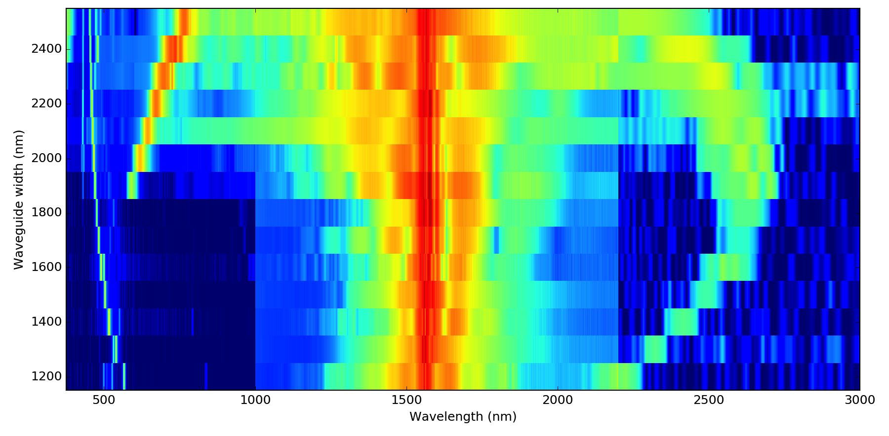
Experimental supercontinuum
Experimental supercontinuum from ~640-nm-thickness SiN waveguides
Notes:
Here is the exact same data presented in a slightly different way, with the wavelength still on the horizontal axis, the waveguide width on the vertical axis, and the intensity of the light represented by the color. This just makes it a bit more clear how short wavelength dispersive wave moving to longer wavelengths, while this long wavelength DW moves outwards and then back closer to the pump.

Slide 22
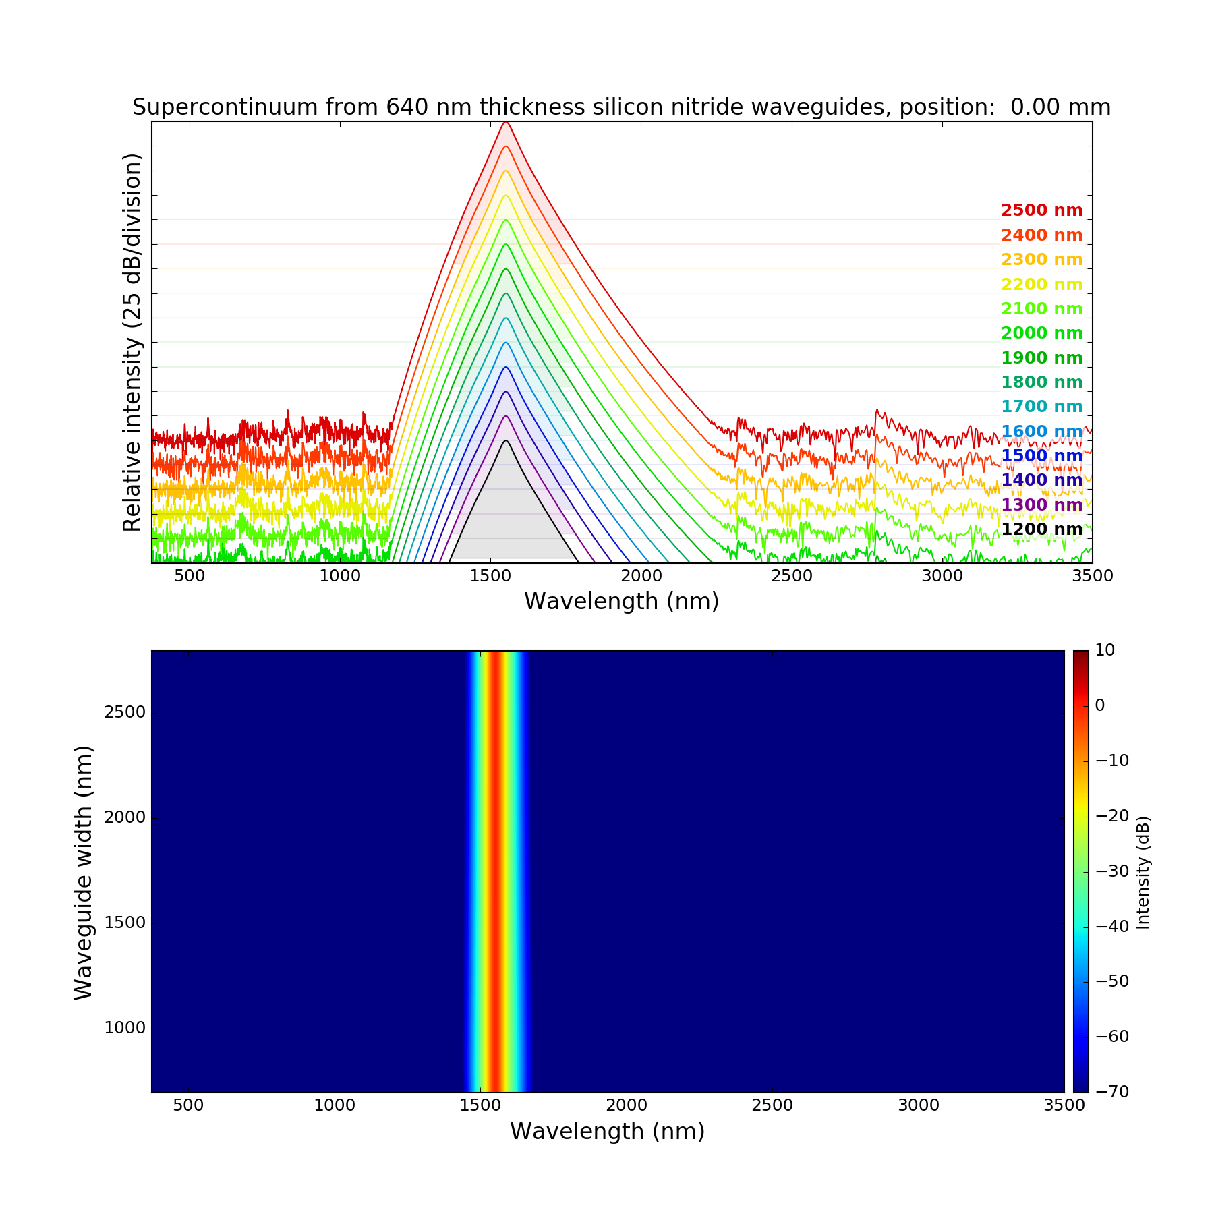
Notes:
And we don’t need to guess about what spectrum will be produced from a specific waveguide. We can accurately calculate the dispersion of the waveguide using a mode-solver. And we can then calculate the propagation of the light numerically using the nonlinear Schrodinger equation.
So, here I am showing the spectrum for various waveguide widths. It starts off narrow, but then, as we propagate along the waveguide, it broadens.

Slide 23

Notes:
As you can see, we reproduce both the short-wavelength and the long-wavelength dispersive waves.

Slide 24
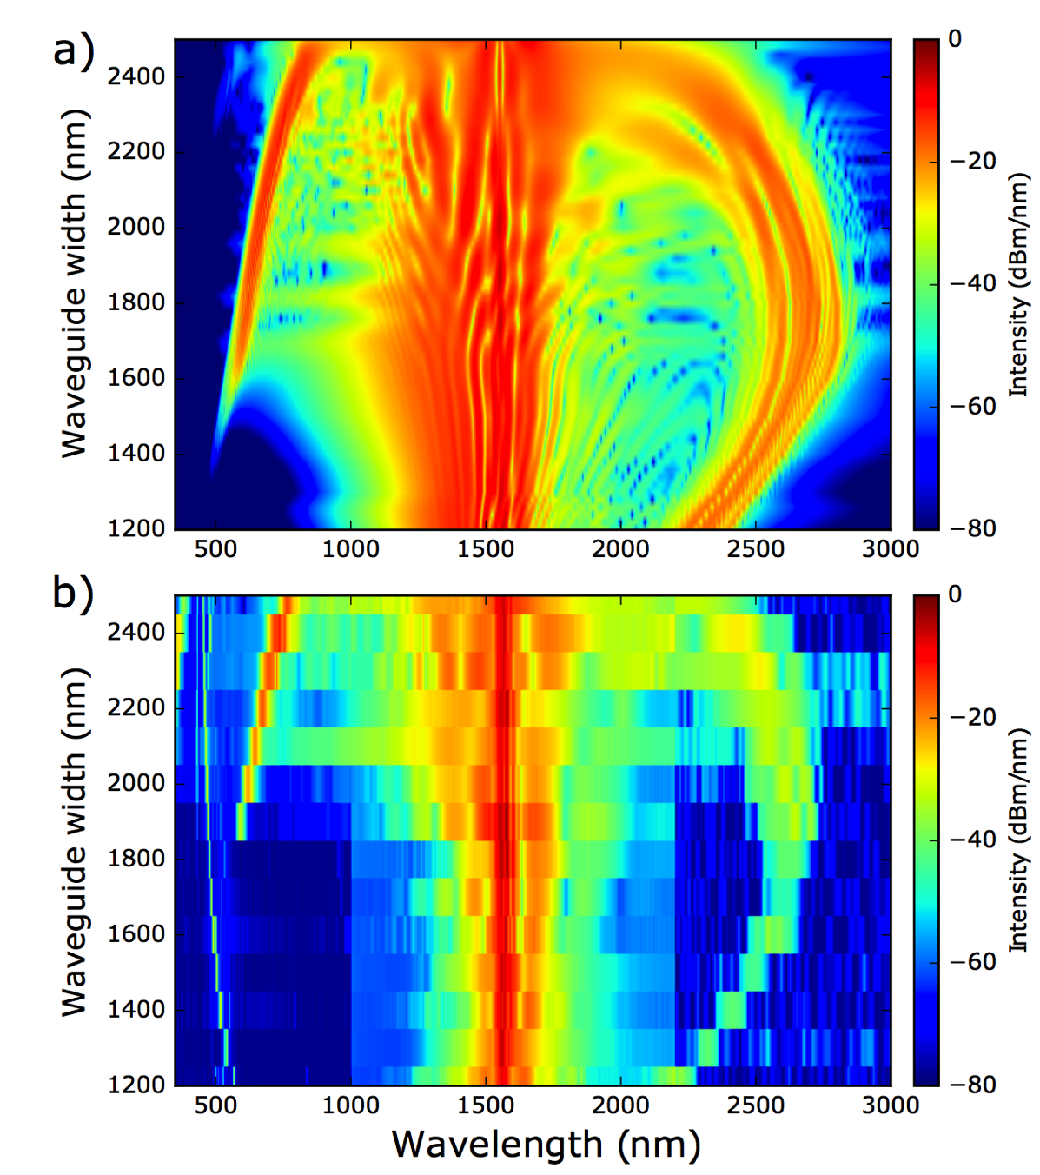
Comparison to NLSE
NLSE
Theory
Experiment
Notes:
We can compare this with the experiment, and see that all of the major features are reproduced. DWs occur on both sides.
This excellent agreement between simulations and experiment means that we can have some confidence that we can use NLSE simulations to make accurate predictions about what spectra can be produced.

Slide 25
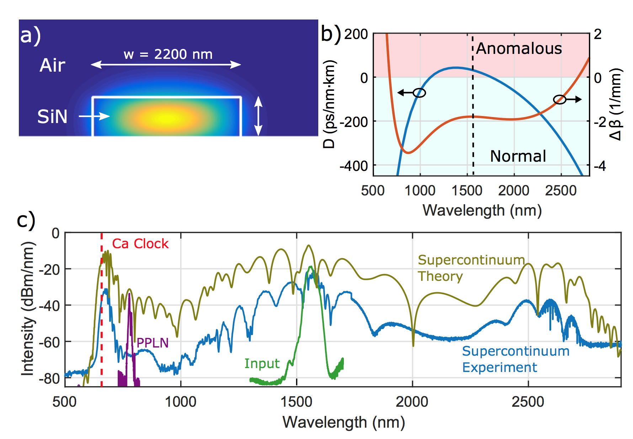
Supercontinuum to 657 nm
Notes:
And these broadband spectra enable some new capabilities. Previously, it was not really possible to take a fiber comb at 1550 and directly generate light at 657-nm to match the light generated by the calcium clock. But, with the silicon nitride waveguides, we can reach all the way out to the countryside and generate light at 657 nm, and generate bright light at most of the other optical clock transitions as well.

Slide 26
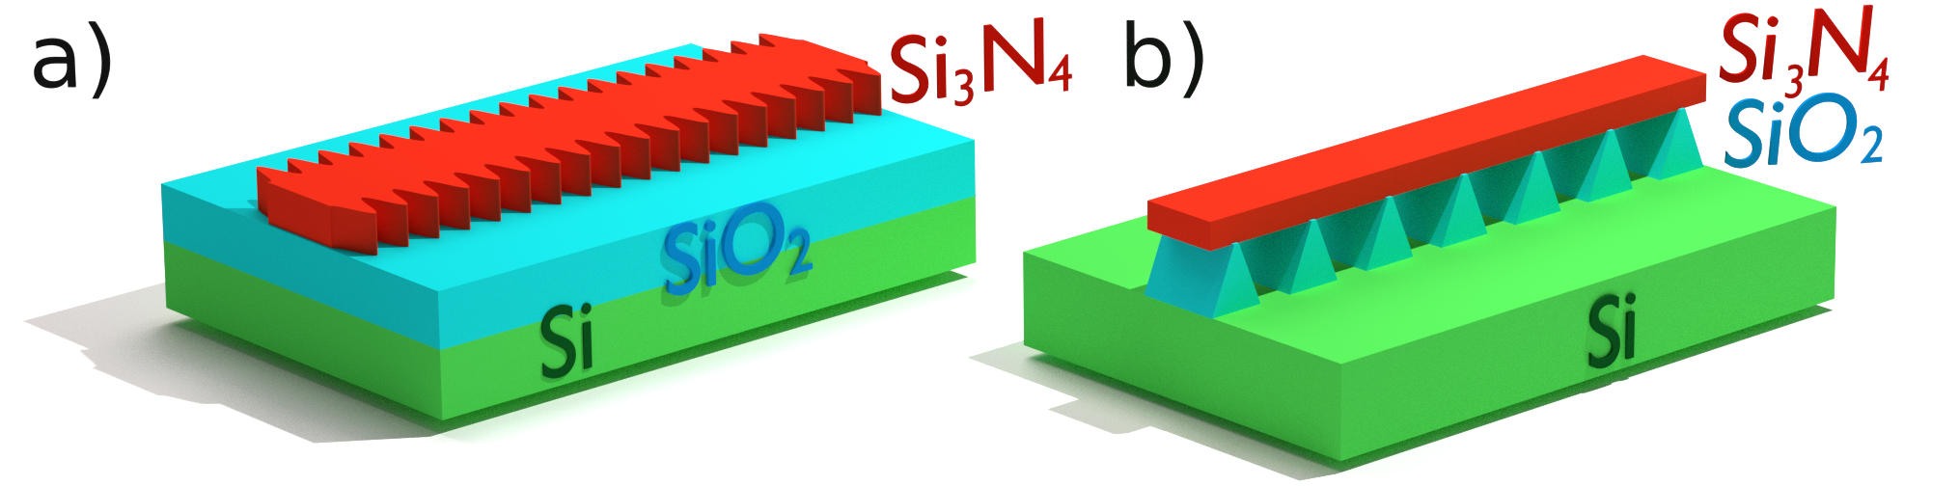
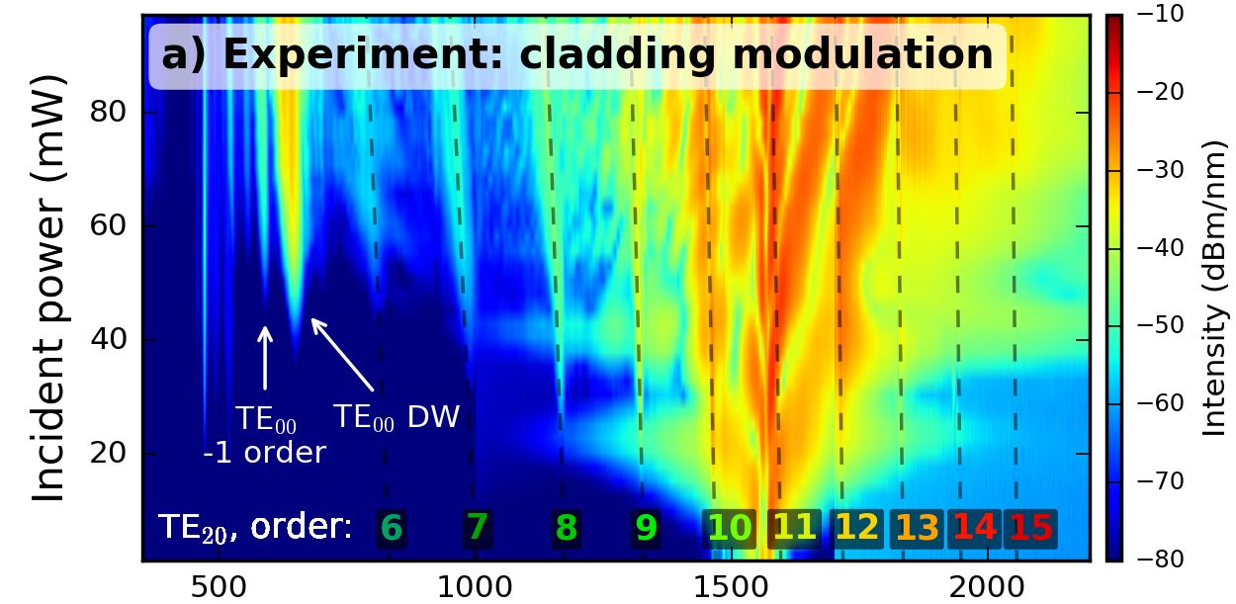
2. Modulated structures for spectral shaping
Wavelength (nm)
Notes:
With on chip-waveguides, it is easy to make really unusual waveguide geometries. One of our big questions was if we could use unusual waveguide geometries to shape the spectrum of the supercontinuum spectrum to tailor it for specific applications.
We actually stumbled across one way to do this completely by accident. Some of our collaborators had fabricated waveguides with periodic modulations, in one case the waveguide width was modulated along the length of the waveguide, and in another case the waveguide was sitting perched on top of these regularly spaced support structures.
In both cases, we saw light generated in spectral regions where it otherwise would not be seen. Here I am showing the spectrum versus incident power for the suspended waveguide structures. There are these bright peaks in the supercontinuum spectrum, which are enabled through a quasi-phase-matching effect enabled by the regular modulation of the waveguide refractive index. So, we could potentially design the periodicity of the structure just right in order to place these peaks right where we wanted a boost in the intensity of the light, for example, at the wavelengths where we have atomic clocks.

Slide 27
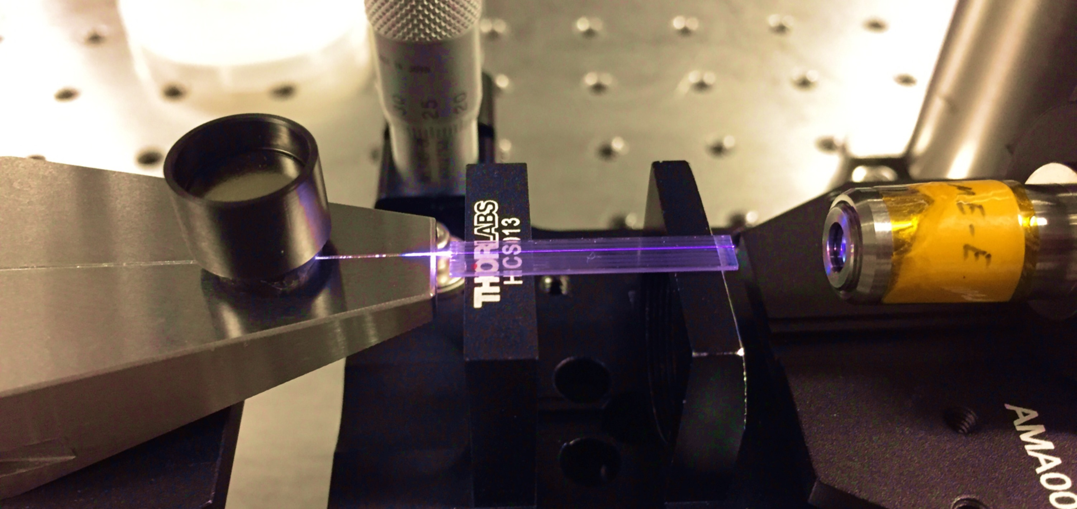
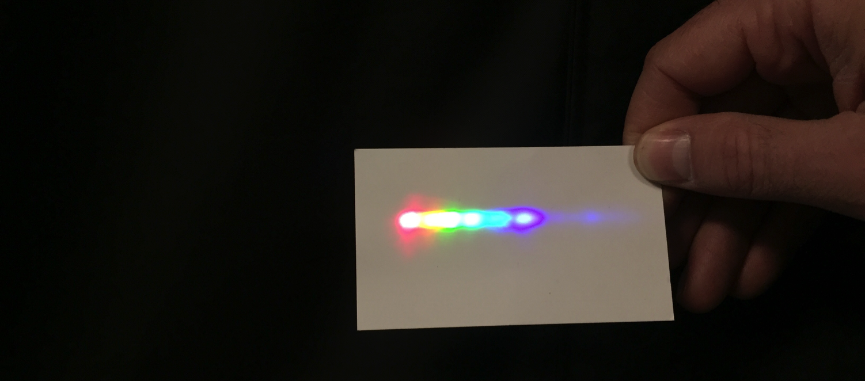
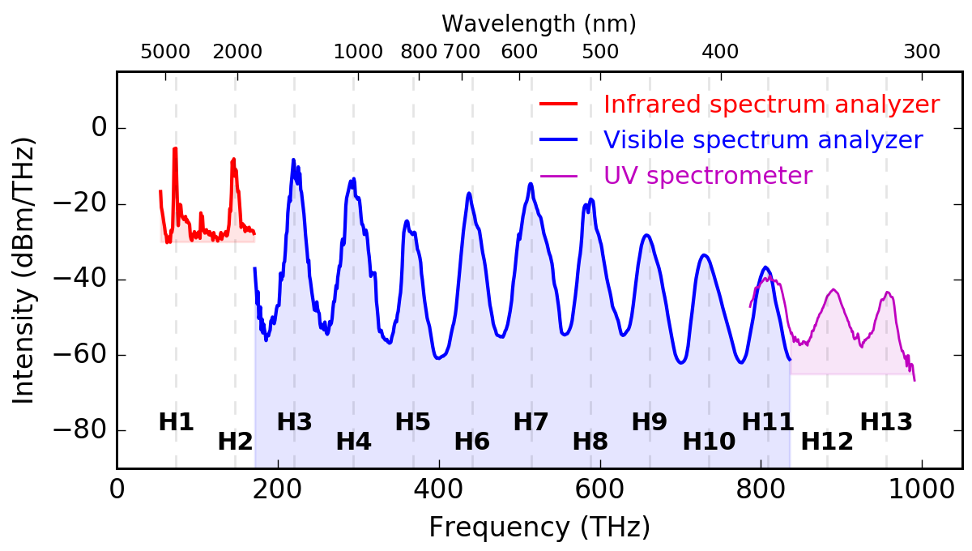
3. High harmonic generation (HHG)
Harmonic light dispersed with prism
25 mm
PPLN
waveguides
4100 nm
~10 nJ
400 nm
Notes:
Since I did my PhD in high-harmonic generation, I was curious if waveguides could serve as a useful platform for high-harmonic generation. So, we took some of our periodically poled lithium niobate, or PPLN waveguides over to KMLabs, a laser company in just a few miles east of here, and tested them with their 1 MHz laser at 4100 nm.
And indeed, even starting with a laser way into the infrared, we generate lots of clearly visible light. Here you can see the chip glowing purple, and here you can see the harmonics after the light is dispersed with a prism.
The spectrum was so broad, that we needed three different broadband spectrometers to capture the whole thing. It spans from the mid-infrared all the way into the ultraviolet. And we got all the way up to the 13th harmonic. So, it looks like waveguides are a potentially very interesting platform for high-harmonic generation, and possible a useful source of light in the ultraviolet range or beyond.

Slide 28
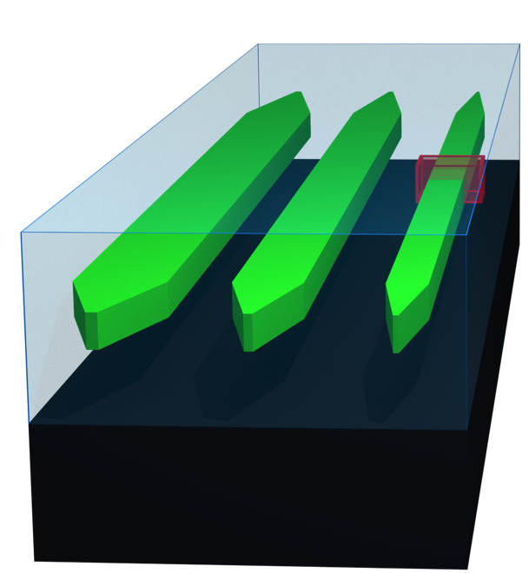
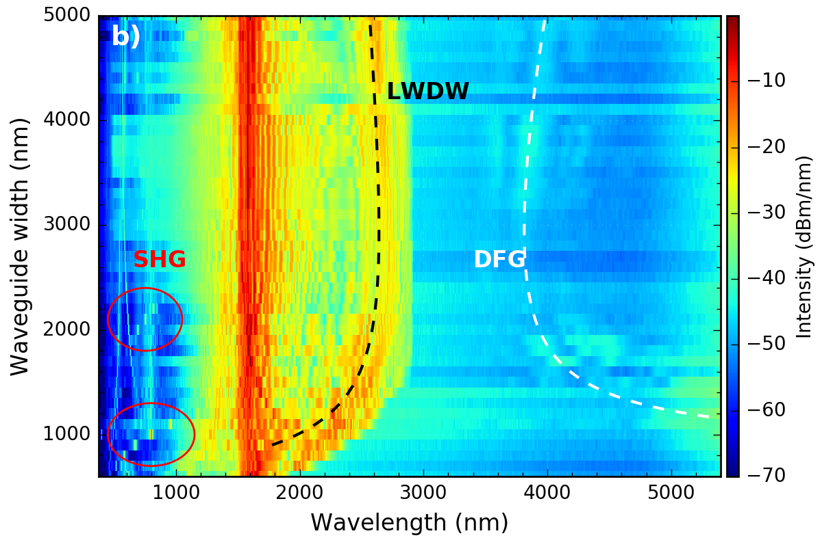
4. Simplified self-referencing with AlN
SiO2 cladding
(thickness 5000 nm)
AlN waveguides
(thickness 800 nm)
Si substrate
Notes:
Another question that we had was if waveguides could allow us to simplify the whole self-referencing process. For this, we used AlN waveguides. These waveguides were made by Hojoong, who I believe is in the audience, but he made them back when he was working with Hong Tang’s group at Yale. And, I guess they worked really well, and that’s probably why our group hired him as a postdoc.
Aluminum Nitride is similar to SIN, and you can see here that it also generated a nice supercontinuum spectrum, and that the spectrum changes as we change the width of the waveguide. But, the key difference is SiN only has a Chi-3 nonlinearity. Aluminum nitride has both Chi-3, which is what makes the supercontinuum, but also a chi-2, which allows second harmonic generation or SHG to happen.
So, in the 780-nm region we have some second harmonic that is overlapping with the supercontinuum light. This means that we can simply detect the light in this region and obtain the offset beat.

Slide 29
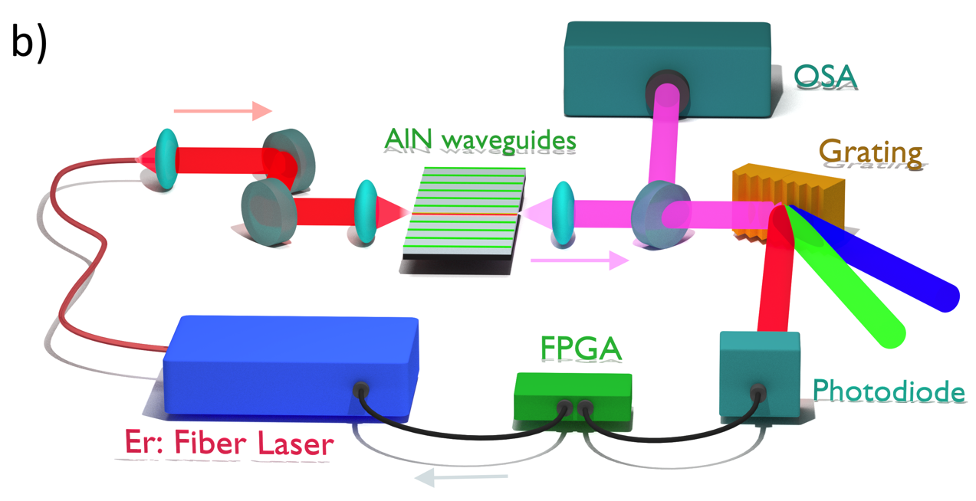
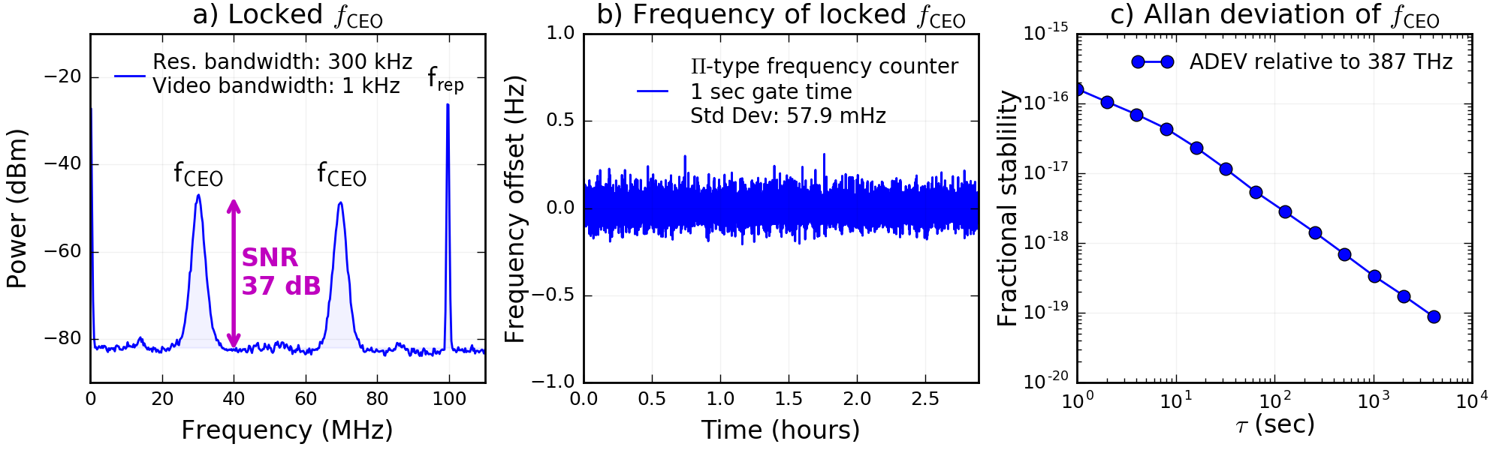
Simplified self-referencing
Notes:
So, instead of needing a complicated interferometer and separate crystal to generate the second harmonic, we have a very simple setup, where the laser goes into the waveguide, all of the colors come out. We use a grating to select just the 780-nm region, and we detect the signal on the photodiode and use this to stabilize our frequency comb. The graph down here just show that we have over 30 dB of signal-to-noise on the offset frequency signal, and this means that we can do just as good of a job of stabilizing the offset frequency as can be done with more complicated methods. As shown by these two graphs.

Slide 30
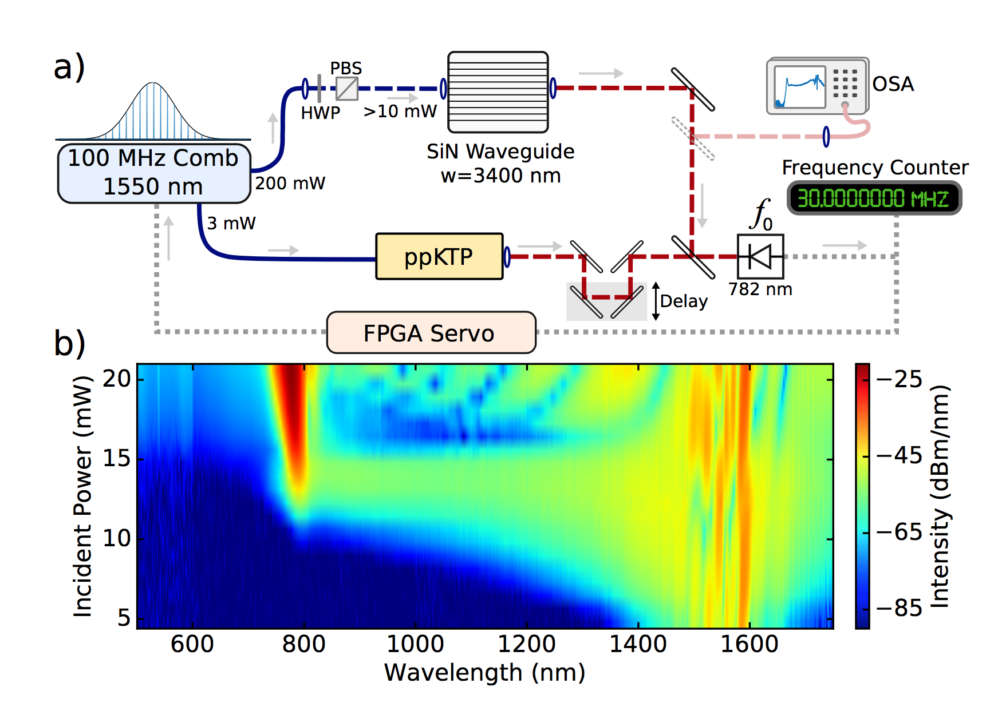
5. Low-power self-referencing
Notes:
Practically speaking, the simplified self-referencing with Aluminum nitride still requires about 1 nJ of pulse energy. So, we wanted to know if the silicon nitride waveguides would let us self-reference a frequency comb using less power than usual. The experimental setup is fairly simple, we sent 3 mW of power to a SHG crystal to provide the second harmonic light at 780 nm. Then, we sent the rest of the laser into the waveguide, and included an attenuator before the chip so that we could control the intensity of the light.
Here is the spectra at various intensities of the pump laser. At powers greater than about 10 mW, we were able to generate light directly at the second harmonic of the pump. This is an unusual way to self reference a laser frequency comb, and it’s enabled by the fact that the on-chip waveguides allow us to generate light much farther from the pump than is typically possible with nonlinear fiber. Usually, we would take a nonlinear fiber, generate light at 2 micron, generate light at 1 micron, and double the 2 micron light for self-referencing. This works fine, but it suffers from the fact that there often isn’t much light at 2 micron. Then, when you double the 2 micron light, the pulse might not be particularly short and so the conversion efficiency isn’t great. Now, you are interfering dim light with other dim light, and the heterodyne signal can be very weak, unless you have a large amount of laser power available.
In this scheme, we are generating light directly at the second harmonic. Now, we can double the strong pump light at 1560, which is bright and has a short pulse duration, so the conversion efficiency is very good. Now, we can interfere strong second harmonic light with the supercontinuum light. So, this can allow us to detect the heterodyne beat even when the input pulse energies are fairly low.

Slide 31
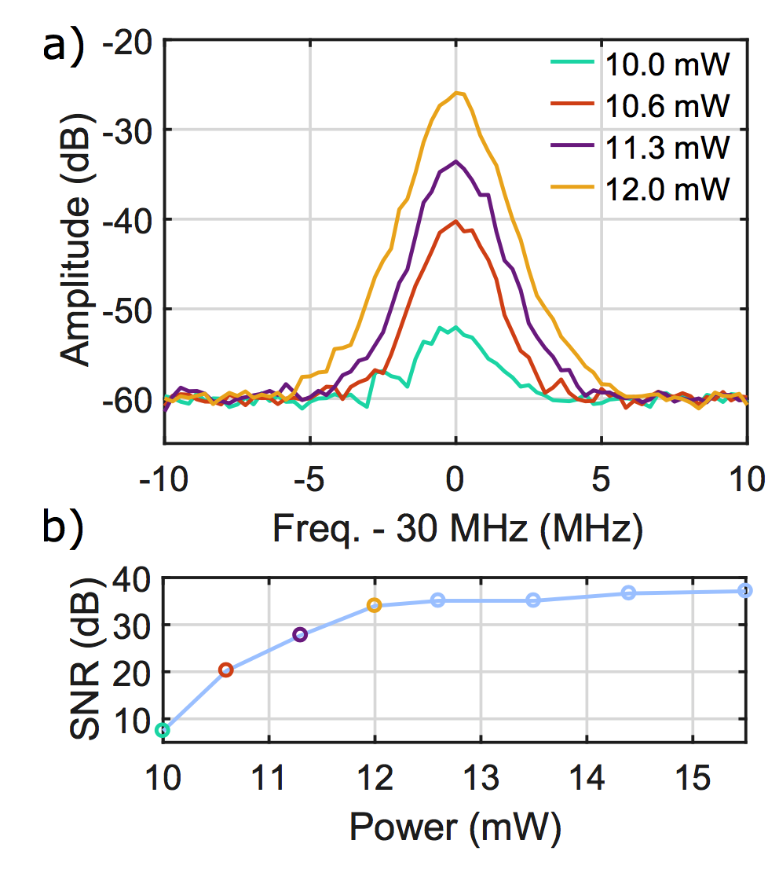
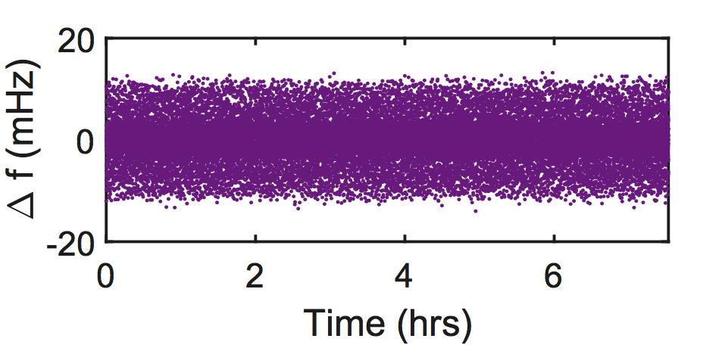
5. Low-power self-referencing
Notes:
And here is what the f0 beat looks like at various input powers to the waveguide. We are at 100 MHz, so these are pulse energies of, for example, 120 pJ. Basically we want this peak to be as large as possible. Anything over 25 dB is usually sufficient for glitch-free locking of a frequency comb. And here you can see that we achieve better than 25 dB SNR as long as the power is over 11.3 mW. Using this 11.3 mW level input to the waveguide, we are able to lock the CEO of the comb and then count the offset frequency with a separate counter. We get this purple trace here, which shows the frequency (counted with a 1 second gate time) stays within the target frequency at the milliHz level, which is limited only by feedback bandwidth of the laser and not by our detection scheme.
So, this shows that yes, even with the current technologies, silicon nitride waveguides can allow us to easily self reference low pulse energies that would be very difficult to broaden in HNLF. As we make more improvements to the coupling, to the materials, and to the waveguide design, it should be possible to push this orders of magnitude better.
And, while these results were obtained just by taking a high power laser and attenuating the power, our silicon nitride waveguides are allowing us to spectrally broaden and self-reference low-power consumption combs.

Slide 32
Battery powered comb self referenced!
Notes:
Here is an low-power consumption comb that was developed at NIST for applications like sattelites where you can only get a few watts of electrical power. Here you can see the comb running off of a cell-phone charger. The downside of such a low-power comb is that the pulse energies are so low that it could never be broadened in nonlinear fiber. But, using the silicon nitride waveguides we were able to generate light directly at 780-nm and self reference the comb.
I think that this is one of the first, if not the first fully stabilized frequency combs to be running off battery power.

Slide 33


6. 10 GHz Electro-optic comb
Phase + intensity modulation carves CW laser into pulses (no mode locking)
Tunable repetition rate
Flat spectrum
Telecom components
~10 GHz repetition rate
4+ Watts of power.
Notes:
So, the last application of the on-chip waveguides that I will talk about is to broaden a 10 GHz electro-optic comb. Electro-optic combs are probably the most bone-headed way to make a frequency comb, but recently, they have actually become a really good way to make a frequency comb.
Basically, you just take a continuous laser and, using electro-optic phase and intensity modulators, you chop the laser up into chirped pulses, when can then be compressed using some dispersive medium, like a whole bunch of single-mode fiber. It has some pretty unique capabilities, like the ability to operate at really high repetition rates, and the ability to tune the repetition rate, and the fact that it deterministically generates pulses, without the need to be mode-locked like a normal laser. But, the spectrum that it produces is quite narrow, and the fact that the repetition rate is around 10 GHz means that, even if we amplify it to 4 Watts of optical power, the pulse energies are still really low.

Slide 34


Flat broadband spectra
20 dB attenuator
@ 1550 nm
Notes:
But, again, the high nonlinearity of the silicon nitride waveguides allows us to broaden the spectrum to way more than once octave, and generate light directly at the second harmonic of the 1550 nm pump laser. Excitingly, just relying on the fact that a 20 dB attenuator has a frequency dependent attenuation, we can flatten the spectrum so that there is only a 3 dB variation over several hundred nm of bandwidth, which could make this comb an appealing source for spectroscopy of calibrating astronomical spectrographs in this region.

Slide 35

EO-comb with sub-cycle timing jitter
Sub-cycle timing jitter (1.4 fs, 10 Hz to 4 MHz)
Fractional frequency synthesis accuracy <3e-17
Runs continuously >16 hrs
Notes:
The broad spectrum lets us self-reference the comb, and we have been able to reduce the phase-noise of the comb. We started at this green line and, after self-referencing and a few other tricks, we arrived at this purple line. The important thing is that this purple line stays below this threshold, known “beta separation line”. When this phase-noise is integrated, the integrated timing jitter is less than 1.4 femtosecond, which is less than half an optical cycle. This is the first EO comb to show stability on this level, and it means that it’s ready for high-precision comparison of optical clocks and for dual-comb spectroscopy.

Slide 36

Few-cycle pulses @ 10 GHz
Experimental
Reconstructed
Error = 1.6%
Notes:
If we adjust the input power so that the soliton fission process occurs right at the end of the waveguide, then we generate a somewhat less broad spectrum, but we can get pulses that are reasonable well compressed. In this case, we were able to get a pulse with a duration of only 15 femtoseonds.

Slide 37

10 GHz ultrafast, ultrastable
Coherent Raman imaging with dual combs
Collaboration with Marc Cicerone and Charles Camp at NIST-G
Notes:
So, what are we going to do with this 10 GHz source that is both ultrafast and ultrastable?
Well, one application that is looking for high-rep rate sources of few-cycle pulses is coherent Raman imaging, which is this cool microscopy technique that record the entire vibrational spectrum at each pixel in a 3D sample. So, you can make cool images like this one, where you are moving through the thickness of a skin sample, and there is no need to prepare the sample using chemical dyes. We are collaborating with some Raman experts at NIST gaithersburg to try to demonstrate that our combs are capable of collecting images like these faster than ever before.

Slide 38
Waveguide supercontinuum
On-chip supercontinuum sources allow us to:
Access 350 to >3000 nm* using a 1550 nm pump
Control the spectral shape
Generate up to the 13th harmonic
Self-reference with a single waveguide
Self-reference a battery-powered comb
Generate few-cycle pulses at 10 GHz repetition rates
*Some spectral regions may be dim. Use at your own risk.
Notes:
So, the simulations presented an optimistic view that we could really do a lot of cool things with these on-chip waveguides. But, just because the computer says that it should be possible doesn’t mean that it will necessarily work out so well in experiment.
So, we had a whole bunch of questions about what waveguide supercontinuum could accomplish, and we conducted experiment to answer these questions.
First, we wanted to know if waveguides would allow us to generate light in spectral regions that were otherwise inaccessible using a traditional supercontinuum source.
Second, we wanted to know if waveguides would give us some additional control over the spectral shape of the supercontinuum.
We wanted to know if we could use simultaneous second harmonic generation and supercontinuum generation in a single waveguide to produce a simplified self referencing setup.
Next, we wanted to know if the waveguides would work in the mid-IR, and if high harmonic generation was possible.
Can waveguides allow us to use pulse energies so low that we can still broaden and self-reference a comb that runs entirely on a small battery pack.
Finally, we wanted to see if the waveguides could broaden the spectrum and compress the pulse to just a few optical cycles, even at 10 GHz repetition rates?
So, I’ll briefly tell you about the experiments that we completed that showed that the answer to all of these questions was yes.

Slide 39





Future Questions
Coherent Raman images with 10 GHz comb?
Dual-comb spectroscopy in the mid-IR?
Miniaturize? Leave the lab?
Enable new applications? <insert yours here!>
Thank you!
daniel.hickstein@nist.gov
Notes:
Going forward, we have a few more questions to answer. First, can we generate few-cycle pulses at GHz repetition rates.
And there are probably lots of other applications for these waveguides or these broadband laser sources, so if this seems interesting to you, please get it touch, because we are always looking for new collaborations.
Thank you for your attention!

Slide 40
Split waveguides

Slide 41


Supercontinuum with a microresonator comb
15 GHz silica disk resonator
Single and double Kerr-soliton states
Self-referencing achieved with SiN
Used to perform ultra-stable optical cavity comparison
See paper: Lamb et al., arxiv.org/abs/1710.02872
SiN supercontinuum
f₀

Slide 42


Waveguides for optical atomic clock comparisons
Notes:
So, the next question we had is how useful these on-chip supercontinuum sources would be for generating comb light for comparing various optical atomic clocks. Using NLSE simulations, we can calculate which waveguide dimensions can be used to produce spectra that are have light concentrated into regions where there are atomic clock transitions. For example, at 657 nm for Calcium, 699 nm for strontium, 775 for self referencing, and in the 1100 nm region for aluminum, mercury, and ytterbium clock.
And, we could think about designing a single chip that takes a single input, and delivers several outputs, each with a spectrum that is specifically designed to concentrate the light for a specific optical clock. But, the question is: does the supercontinuum generation process preserve the high stability of the input comb and allow for the precision comparison of atomic clocks.

Slide 43

10⁻¹⁵ stability
Notes:
In short, yes it does. Here we performed a comparison between two ultrastable lasers: one at 1550 nm and one at 657 nm. And, here is the Allan deviation of the. At short times, we are limited by the maser reference used for our locking electronics, and at long times we are limited by the drift of the cavities. So we can see that we are right where we expected to be if our comb was adding zero noise to the measurement. So, we have demonstrated that our SiN supercontinuum isn’t adding noise, at least at the 10^-15 level.

Slide 44
Supercontinuum to 657 nm
Notes:
Using a 600 nm thickness, 2200 nm width waveguide, we were able to achieve strong confinement of the 1550 nm light, as shown by this mode-profile here. This provided a dispersion profile shown by this the blue line here, which was anomalous at the pump, allowing for soliton fission to take place.
The spectrum has a dispersive wave very close to the calcium transition at 657 nm. Also, even though this waveguide is not optimized to produce light at 780 nm, we still have enough light in this region so that we can interfere this light with the doubled pump light and measure a carrier-envelope offset frequency of the laser.

Slide 45

Clock comparison
Notes:
Here is a schematic of the test setup. Basically we are taking the light output from the waveguide and making three measurements. First, we are measuring a heterodyne beat with a cavity stabilized laser at 1550 nm. Next, we are taking the 657 nm light and measuring a heterodyne beat with the cavity stabilized laser that is used for the calcium atomic clock. Finally, we are doubling the pump light at 1550 nm and obtaining the carrier-envelope-offset frequency of the laser. We then electronically mix out the carrier-envelope-offset, use one of these beat notes to lock the repetition rate of the comb, and count the other using a frequency counter which provides the relative frequency difference between these two ultrastable cavities. These cavities were not actually locked to atomic transitions, but nothing out this experiment would change if they were. So, this is a proof of principle that we are capable of making comparison of optical atomic clocks.

Slide 46

Waveguides for optical atomic clock comparisons
Notes:
So, the next question we had is how useful these on-chip supercontinuum sources would be for generating comb light for comparing various optical atomic clocks. Using NLSE simulations, we can calculate which waveguide dimensions can be used to produce spectra that are have light concentrated into regions where there are atomic clock transitions. For example, at 657 nm for Calcium, 699 nm for strontium, 775 for self referencing, and in the 1100 nm region for aluminum, mercury, and ytterbium clock.
And, we could think about designing a single chip that takes a single input, and delivers several outputs, each with a spectrum that is specifically designed to concentrate the light for a specific optical clock. But, the question is: does the supercontinuum generation process preserve the high stability of the input comb and allow for the precision comparison of atomic clocks.

Slide 47
2. Waveguides for optical atomic clock comparisons
Notes:
We could think about building a photonic chip that takes a single input, breaks it into several waveguides, where each waveguide is optimized for a specific atomic clock. Of course, this is really convenient, but also, since the pulse energy requirements are lower, you would likely only need one amplifier, instead of an amplifier for each measurement, which could reduce the noise and increase the precision of the measurements.
We haven’t built this dream-chip yet, but we have done a proof-or-principle experiment, where we used the waveguide supercontinuum to make a comparison with NIST’s calcium atomic clock laser.

Slide 48


Mode crossing
Notes:
Here is just a zoom-in of the previous plot showing that narrow peak a little more closely. It turns out that this peak corresponds to a mode-crossing between the lowest order TE mode that we are pumping and t he TM10 mode. Here is a plot for just one waveguide width, showing the refractive index versus waveguide for first 7 modes. You can see that the TE crosses the TM modes. This usually doesn’t happen, but due to the birefringence of AlN, this allows for a mode crossing. Here, I am showing the location of the mode crosing calculated for various waveguide widths. And, in this plot, I have overlayed the orange line with the experimental data, and you can see that there is good agreement. And there is a strong enhancement of the supercontinuum at this location. So, if there was some application where we wanted two peaks in our supercontinuum, at both the dispersive wave and another location, well, now we can provide that!

Slide 49

Comparison with theory
Nonlinear Schrodinger Equation (NLSE) simulations with PyNLO: github.com/pyNLO
Notes:
So, we might ask how well we can reproduce our experimental results with theory. We used the nonlinear Schrodinger equation propagated with the split-step Fourier method, as implemented in the PyNLO package.

Slide 50

Comparison with theory
Nonlinear Schrodinger Equation (NLSE) simulations with PyNLO: github.com/pyNLO
Notes:
The agreement is pretty good, especially with this short wavelength dispersive wave. The long wavelength DW is also reproduces, and this small discrepancy in the in the location of the long-wavelength dispersive turned out to be caused by a small discrepancy in the film thickness.

Slide 51

TE: Broadband supercontinuum
Notes:
So, first of all, I should point out that AlN has a decent Chi-3, and makes great superocntinuum. Here, we are pumping in the TE direction, which is when the chi-2 is zero. And we see that, just like SiN, we can make a dispersive wave across the visible region, and also make a long wavelength dispersive wave out to 4 micron.
Additionally, because the material is birefringent, we have some additional light generated through a mode-crossing with a higher-order mode.

Slide 52


Slide 53

4. Mid-infrared supercontinuum generation
1 MHz, 2800-nm, 200 fs pulses
Wavelength (nm)
Notes:
We wanted to know if silicon nitride waveguides could still produce supercontinuum even when longer wavelength pump pulses are used. So, we took some of our silicon nitride waveguides over to KMLabs, a laser company just a few miles east of here where they have a 1 MHz mid-infrared laser. Here we were able to generate an octave spanning spectrum starting with a 2800 nm laser pulse. So, while this experiment wasn’t completed with a frequency comb, it suggests that these photonic waveguides

